Slide 1
Delivering a Digital Foundation for Healthcare
Notes:
Today we are going to discuss VMware's digital foundation for healthcare strategy and how we can partner to support your organization on it’s digital transformation journey

Slide 2
Agenda
Overview of Digital Transformation in Healthcare
Modernize HIT Through Cloud Transformation
Empower Connected Care and the Hybrid Workforce
Deliver Cloud Native Digital Patient Engagement
Notes:
We are going to first discuss an overview of digital transformation in healthcare and see if the issues resonate with you.
We will then address key areas where VMware can support your organizational goals through
Modernization of HIT through cloud transformation
Empowering Connected Care and the Hybrid Workforce
Finally Delivering cloud native digital patient engagement

Slide 3
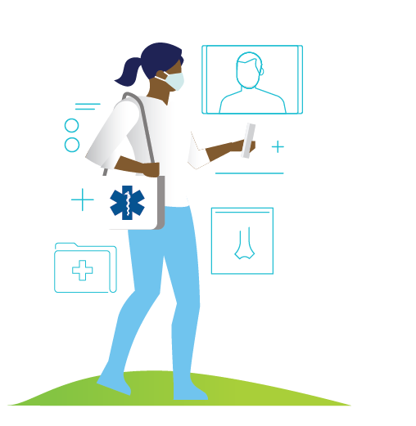
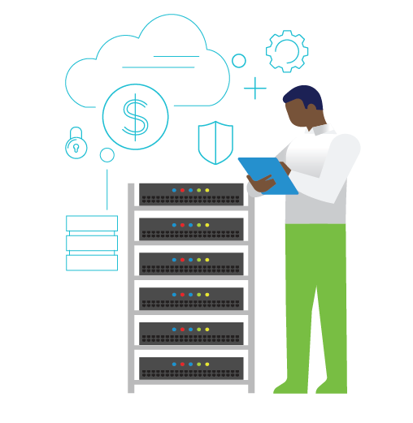
Every Aspect of Healthcare Has Changed
PROVIDERS
PATIENTS
HEALTH IT
61% of employees prefer a hybrid work approach¹*
82% of consumers want digital options to monitor health²
75% of providers expect to increase IT cloud spend³
Enboy & Wakefield Reearch Study on Remote Work N=1000 US Workers February 2021 (link)
Mckinsey COVID-19 Consumer Survey April 27, 2020 (link)
Market Trends: The Rapidly Growing Cloud Opportunity in Healthcare Providers Published 24 March 2021
Notes:
Healthcare delivery has changed
Technology Savvy populations that are increasingly accepting of devices monitoring their every movement are looking for their healthcare providers to have the same kind of insights as their mobile phone provider.
On the provider side staff are looking for more flexibility – where appropriate – and healthcare organizations are seeing benefits in being able to hire for certain roles including back-office, finance and IT roles from across the country opening up wider candidate choices.
And as for health IT – in many ways the shackles that have held back progress are starting to come off.

Slide 4
International healthcare is evolving and digitally transforming
US: New Remote Patient Monitoring Codes
UK: NHS Digital / NHS Transformation Directorate
Germany: Digital Healthcare Act - DVG
Brazil: National Digital Health Strategy
Australia: “Permanent” telehealth investment
Notes:
Globally we are seeing funding and re-imbursement that is being made available by governments around the world who recognize the benefits that can be achieved through digital healthcare. Similar to how ARRA and HITECH kick started digital healthcare in the US, governments around the world are putting money into digital transformation to try to tackle the issue of rising healthcare costs

Slide 5
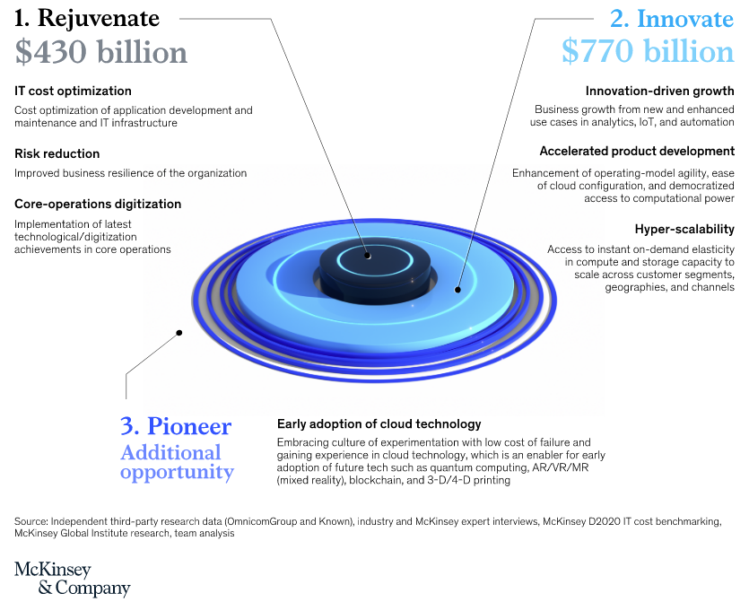
Potential of the Cloud for Healthcare
In 2021 McKinsey showed that cloud capabilities have the potential to generate value of $100-$170b for healthcare by 2030.
Innovation is the primary driver:
Analytics | IoT | Automation
In 2019 a leading EHR provider enabled their infrastructure in the public cloud.
Notes:
This recent report by McKinsey highlights key areas of innovation that will drive economic value in healthcare as healthcare progresses in its move to the cloud. The key areas that they highlight are common discussions that we have with customers. Key areas include
1
IT Cost optimization – including costs of application development, IT infrastructure costs and maintenance costs
Risk reduction – where we see improved availability and failover options and economics in the cloud
Core Operations Digitization – including the ability to quickly adopt and implement new technologies that become available
2.
Innovation driven growth (analytics, IoT, automation) – There are a lot of discussion in healthcare around the power of AI in helping to make faster, more informed decisions for patient care
Accelerated product development – An area that is still relatively limited in healthcare – but we are starting to see become more of a focus as the ownership of the digital patient experience has benefits both on the patient care side but also on the competitive aspect of the healthcare business
Hyper Scalability (On-Demand elasticity) – Whether it’s aquisitions, onboarding new employees or projects or reacting to scenarios including the pandemic, the accessibility of new compute resources to quickly enact projects can be a critical advantage
While there is much potential for healthcare, healthcare has been held back – but that is changing…

Slide 6
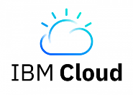
Path to Cloud Can Be Complex and Costly
Private Cloud
Notes:
The cloud certainly creates a lot of potential – but moving to the cloud can be full of challenges.
Healthcare organizations have become experts at running on-premises datacenters or private clouds. The always-on, patient critical nature has shaped this set of investments and skills.
And different clouds have different benefits and resources which is creating a need for most organizations to look to have data and applications in multiple clouds
This requires learning new tools and operational capabilities which can contribute to create new silo’s
That silo approach goes all the way down to the network, to your security stack, all the way to how you connect those applications, and to your end users.

Slide 7
VMware Simplifies the Path to Cloud Innovation
Hybrid Cloud
Notes:
When we look at this environment, this is what VMware does, we turn heterogeneity into a competitive advantage, on Prem? We use the hypervisor to create a level of abstraction that allowed us to pool our resources together and then automate. We unleash tremendous amount of efficiency for our customers delivering a single approach tobuilding, managing , monitoring and securing a multi cloud infrastructure

Slide 8
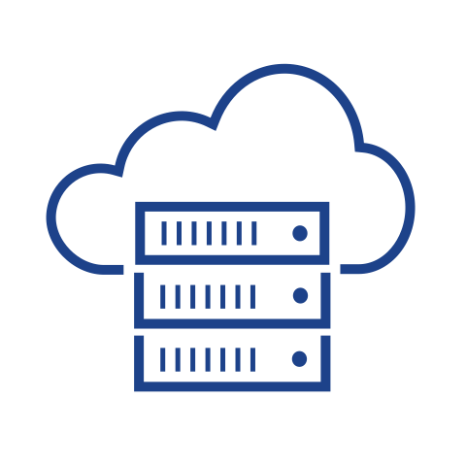
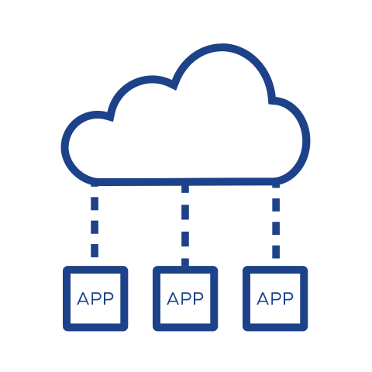
VMware’s multi-cloud platform solves key healthcare requirements
VMware Cross-Cloud Services
Modernize HIT through Cloud Transformation
Empower Connected Care and the Hybrid Workforce
Accelerate Cloud Native Digital Patient Experiences
Cloud Infrastructure
Run enterprise workloads anywhere
Cloud Management
Automate and optimize apps and clouds
Digital Workplace
Secure access to any app on any device
Security & Networking
Connect and secure apps and clouds
App Platform
Build and operate native apps
Notes:
For healthcare, VMware’s strategy is to deliver a platform for healthcare innovation – building on the trusted infrastructure you run right now. There are three key areas to look at:
1. Modernize HIT through Cloud Transformation: A modern infrastructure that enables you to run healthcare workloads and apps on premises or in the cloud, connecting apps through the software defined datacenter, networking, security and storage that is running healthcare today.
2. Empower connected care and the Hybrid Workforce. VMware is the most widely deployed virtual desktop and unified endpoint management solution in healthcare – trusted to provide tap, turn treat secure access to patient information, enable mobile clinical workflows to deliver care anywhere and even provide patients with entertainment information and distraction during stays or treatment. In addition, Workspace ONE has been helping organization coonect remote workers for more than a decade and regularly receives top analyst honors
Finally an application platform to build run and manage modern apps across clouds. This is early days for healthcare - but I will ask – Who should own the patient’s digital experience? Do you have projects to collect more patient information to use for analysis to identify early signs of conditions and intervene earlier with treatment
How do these projects align with your both your priorities and you expectations of how VMware can assist you in meeting your goals?

Slide 9
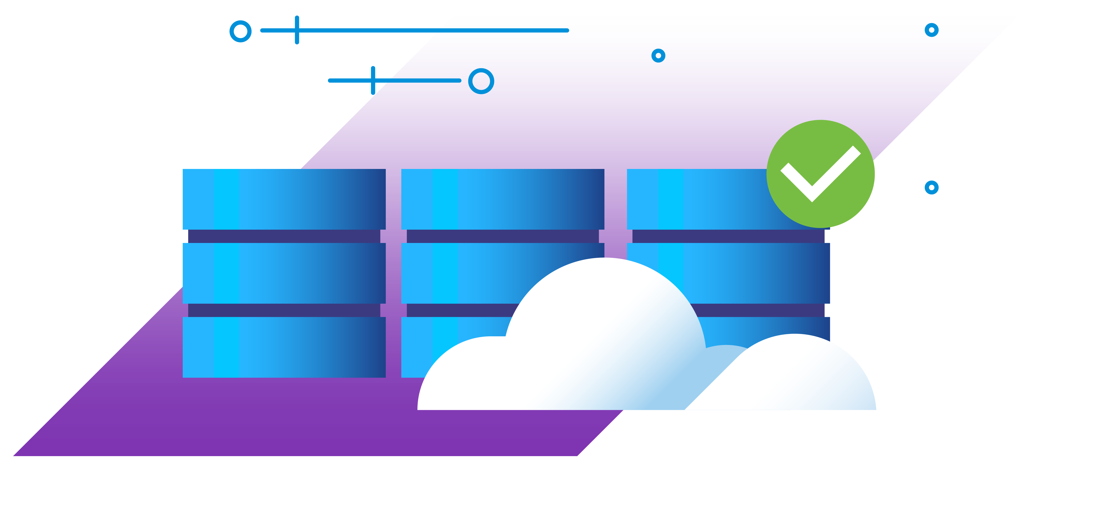
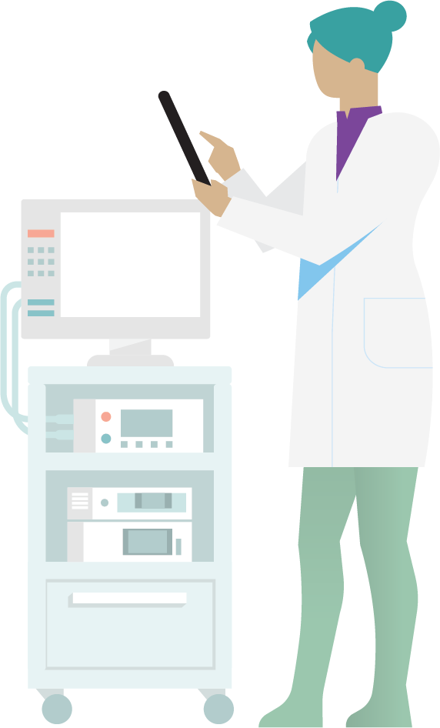
VMware Provides an End-to-End Healthcare Platform
EHR / storage
SASE secure transport
SASE secure transport
Remote Patient Monitoring
Patient engagement
DTX apps
AI / Analytics processing
Provider access and analysis
Notes:
Uniquely, VMware delivers a complete end to end healthcare platform to connect patients and providers.
Lets start on the right side of this diagram. There are two main areas where VMware partners with healthcare organizations today – the datacenter of course, and enabling access to patient information for providers through tap, turn, treat virtual desktops or through mobile devices for applications like Epic’s Rover. Increasingly this access is extending to the homes of your staff, both on the provider and non provider side
Providers are accessing this information from the EHR. The EHR and other critical apps are often running in the datacenter, virtualized with VMware’s SDDC solutions – but as we’ve mentioned, moving to the cloud supported by VMware’s multi-cloud offerings.
Through this multi-cloud approach patient information can be utilized by AI and ML engines in different cloud providers to generate insight into patient conditions
And in a relatively new step, we are seeing more and more hospital at home and remote patient monitoring opportunities through new modern apps utilizing the Tanzu platform and Workspace ONE managed devices as part of a remote patient monitoring kit.
A secure, performant transport through VMware SASE and SD-WAN solutions connects this platform securely transporting patient information and delivering a high quality experience for the provider

Slide 10
Modernize HIT Through Cloud Transformation
Notes:
Lets take a closer look into our first solution

Slide 11
The State of Healthcare Cloud Transformation
Cloud and app modernization take priority with complexity building
73%
of healthcare executives are looking to improve consistency across their public cloud deployments¹
57%
report the complexity of their cloud infrastructure is increasing in 2022²
59%
believe more agile entrants to the healthcare industry are taking market share³
1 VMware FY22 Q4 Executive Pulse
2 VMware FY22 Q3 Executive Pulse
3 Forbes CIO Survey
Notes:
When we speak to and survey organizations like your own, we hear that the majority of organizations recognize value in moving to the cloud, and many will have a target timeline often driven by hardware refresh cycles. Would that be the same in your case?
While the benefits of moving to the cloud are recognized, organizations are also seeing the complexities.
We continually see that embracing cloud creates new silo’s or operations and management and that obtaining and retaining the skillsets to run multiple environments is very challenging hence research findings that point to a need to improve the consistency across cloud environments
We know that healthcare providers are under a great deal of competitive pressure – not only from established players which may be the hospital across the street, but also from new entrants including high tech and payers – I thought this was an interesting stat – that 59% believe more agile entrants to the healthcare industry are taking market share - where do you see competition in your business?

Slide 12
HIT Modernization Challenges
Modernizing infrastructure, operations and applications
Legacy infrastructure
Aging infrastructure in existing data center
High costs - expensive HA and DR co-locations
High threat risks
Pressure to share data while at risk of fines and reputational damage
Constrained IT resources
Challenges hiring and retaining IT professionals
Multiple platform skills required
Notes:
Multi-cloud should be about simplicity – That’s what many of the benefits point to – faster time to market for new initiatives, reduced management overhead - but the challenges can be blockers.
Healthcare organizations have become experts at running on-premises deployments most often built on top of Vmware technology but aging hardware infrastructure. These environments have to be always-on, fast failover and moving them to a different platform opens up a lot of risk.
You’re also under constant attack – while being expected to share data more than ever
And we continually see the challenges in attracting and retaining top IT talent – if you’re on the east or west coast attracting well qualified cloud infrastructure staff is going to put you in competition with a lot of other industries that will often have much larger budgets to play with.
These realities are often roadblocks for organizations to be able to confidently begin a cloud migration program, particularly with hard deadlines such as expiring hardware leases.
Can you share some of the challenges you see in your organization and potential deadlines?

Slide 13
Unique Value of Cloud Transformation with VMware
Simplest path and lowest cost to cloud
Integrated networking and security
Use existing tools, training and talent across clouds
Notes:
Now let’s look at how working with VMware can address these challenges and accelerate your cloud transformation.
First, with VMware Cloud, you have the fastest path for migration. This gives you the flexibility of the cloud anywhere you want it – whether in a target public cloud, edge location, or your own datacenter. Since it is the same infrastructure everywhere, your workloads and apps are completely portable without refactoring. If you have a deadline to meet, there is no faster way to move than with VMware
Second, networking and security is integrated with VMware’s NSX, SASE and SD-WAN technologies. VMware is the only provider to have visibility into all four areas or the Zero Trust model – at the workload with Carbon Black, Network with NSX, User and endpoint with Workspace ONE.
Finally utilizing the existing tools your organizations have become experts with through building best in class always-on datacenters. The investments you’ve made translate directly to managing these workloads in the cloud to the same level of performance

Slide 14
4 Steps to Lead Digital HIT Transformation
Migrate from on-premises to cross cloud infrastructure
1
Combat cyber-attacks and ransomware
2
Modernize and optimize EHR and enterprise applications
3
Connect distributed healthcare delivery sites
4
Notes:
Let’s talk about major projects, which are important to you, and how we can partner to ensure success
Migrate from on-premises to cross cloud infrastructure.
We often see organizations with hardware refresh cycles that are accelerating cloud projects. We can help meet those deadlines accelerating cloud migration
Combat Cyber Attacks and Ransomware
VMware is the only solution to have visibility into every area of the Zero Trust model and can help mitigate the chances of attack and increase speed of recovery
Modernize and Optimize EHR
Moving your EHR into the cloud quickly. How many instances of your EHR do you have across test and dev? We can minimize your on promises footprint and move select workloads ahead of the production environment
And finally connecting distributed healthcare delivery sites
- With VMware SASE, networking and SD-WAN technologies we can minimize costs of connecting sites with highly reliable and performant infrastructure

Slide 15
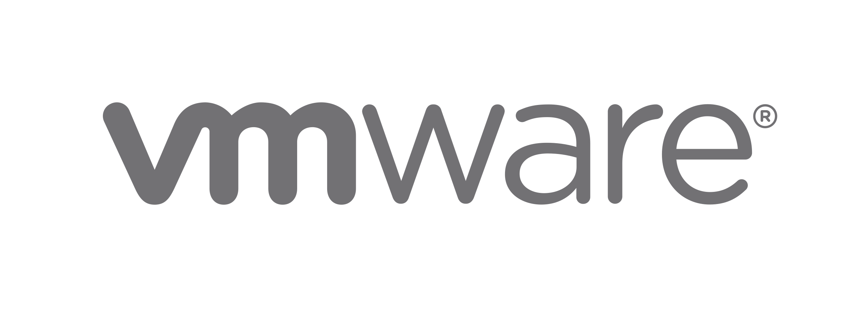
Sentara successfully scaled Epic capacity up to 18,000 concurrent sessions utilizing VMware Cloud with close to 100% uptime, saving $1 million from reduced support and operations costs.
Confidential │ ©2022 VMware, Inc.
15

Slide 16
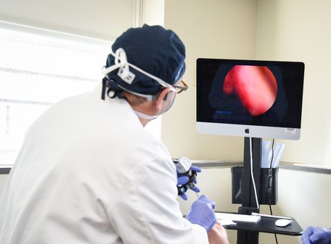
We’re building the foundation with the idea that we can shift workloads to whatever cloud provider is most appropriate for each workload.”
Thomas Balcavage, Senior Vice President and Chief Technology Officer
Confidential │ ©2022 VMware, Inc.
16

Slide 17
Empower Connected Care and the Hybrid Workforce
Notes:
Lets move on to another recent big shift – empowering connected care and the hybrid workforce

Slide 18
Challenges of Today’s Distributed Work Environment
Hybrid is enabling new hiring and retention opportunities
61%
of healthcare executives expect their hybrid workforce to grow in 2022¹
71%
agree that risks related to security and privacy are challenges in delivering work-from-home capabilities²
63%
would lose significant employees without hybrid work practices³
38X
increased telehealth vs pre-COVID levels (July 2021)⁴
1. 1 VMware FY22 Q4 Executive Pulse
2. Forbes CIO Survey
3. Forbes CIO Survey
4. McKinsey July 2021
Notes:
We’ve been getting used to the distributed work world for some time, and hybrid appears to be on a steady growth path as organizations work out how to deliver it. Infact, according to the research, many organizations think they would lose employees if they were to discontinue hybrid and remote working. However, security and legacy technology are getting in the way of experience. Broadly, the challenges are in three buckets.
The first set of challenges is sub-optimal experience. Users are still struggling with poor network performance and using overloaded VPNs over their home internet connection. They have even more apps to connect to that are all over the place, and when they need help, all support has to be remote.
The second set of challenges come from fragmented security. With resources and users widely distributed, the old on-prem network perimeter-based security model is just ineffective much of the time now. 71% of our research participants agree these security risks are getting in the way of delivering work from home capabilities
The last bucket is operational complexity. The patchwork of tools for both management and security just keeps growing, making everything more expensive and complex. Companies always want better ROI, and IT teams want better visibility. Just about everyone agrees that this is going to be a challenging problem this year.

Slide 19
Connected Care & Hybrid Workforce Goals
Enable a hybrid non-clinical workforce
Support remote working for admin, billing, IT
Enable out of state recruiting
Secure access to patient information
Enable providers to securely access PHI from any location and device
Deliver new care services
Quickly enable new care services and patient engagement options
Notes:
These are some of the key goals we see – are these priorities for you or are there other factors that you are focusing on?
Enabling the hybrid non- clinical workforce. We call this out specifically because it isn’t a group of users that have received special attention in the past. We’ve always seen the focus being on the clinical side enabling tap turn treat workflows and more recently digital clinical workflows with mobile versions of clinical applications.
But now we need to securely enable the onboarding and remote working ensuring a great user experience.
Second is the challenge of enabling providers to securely access PHI anywhere – HIT is a little more used to this challenge, but we continue to see the needs evolving for remote access –
bringing us into the third category of how we enable new services – such as telehealth – ensuring providers are able to access the resources and information they need to deliver those services in which the care provider may be in the hospital or clinic, but may also be working from home…

Slide 20
VMware Anywhere Care Workspace
Industry leading solutions that address top healthcare challenges
Secure remote access for clinical and non-clinical use cases
Virtual Apps and Desktops
Tap Turn Treat clinical workflows
Integrated cloud native endpoint security
Support for any device
BYO & 3rd-party managed
Unified Endpoint Management
Hybrid on-premises / cloud deployment options
Quickly enable telehealth and digital care services
SASE network performance management
Integrated video conferencing
Digital Employee Experience
Deliver engaging experiences for improved outcomes
Utilize mobile devices for inpatient engagement
Support remote patient monitoring initiatives
Notes:
VMware Anywhere Care Workspace is a leader across healthcare today.
[Build 1] Secure Remote Access utilizing virtual desktops and apps. The same technology can deliver access anywhere for both your clinical and non clinical users with integrated endpoint security, multi-factor authentication and single sign-on. A single place to go for all of the hospital deployed applications whether windows, mobile or SaaS
[Build 2] Support for any device – BYO or organizationally owned devices, a single management plane for Windows, Android, iOS, and cloud hosted management infrastructure or hybrid should that be a requirement
[Build 3] Quickly enable telehealth and digital care service – ensuring secure access to services and a performant connection for providers delivering those services – we cannot guarantee the connection for the patient on a telehealth call, be we can at least ensure the connection on the provider side is the best it can be. Integrations with Teams and Zoom into virtual desktop technology used to deliver the applications to our providers, and constant monitoring of the users experience and remote support tools to be able to proactive address performance issues.
[Build 4] And delivering engaging experiences for improved outcomes – one of those areas where the innovation is taking place. For some time we’ve been using mobile devices for inpatient engagement, entertainment and distraction – but the move towards reote patient monitoring where we are seeing Workspace ONE managed ipad devices as part of a kit that gets prescribed to the patient.
The result is that by eliminating legacy silos, customers can get better ROI, reduce complexity, and optimize both security and experience today.

Slide 21
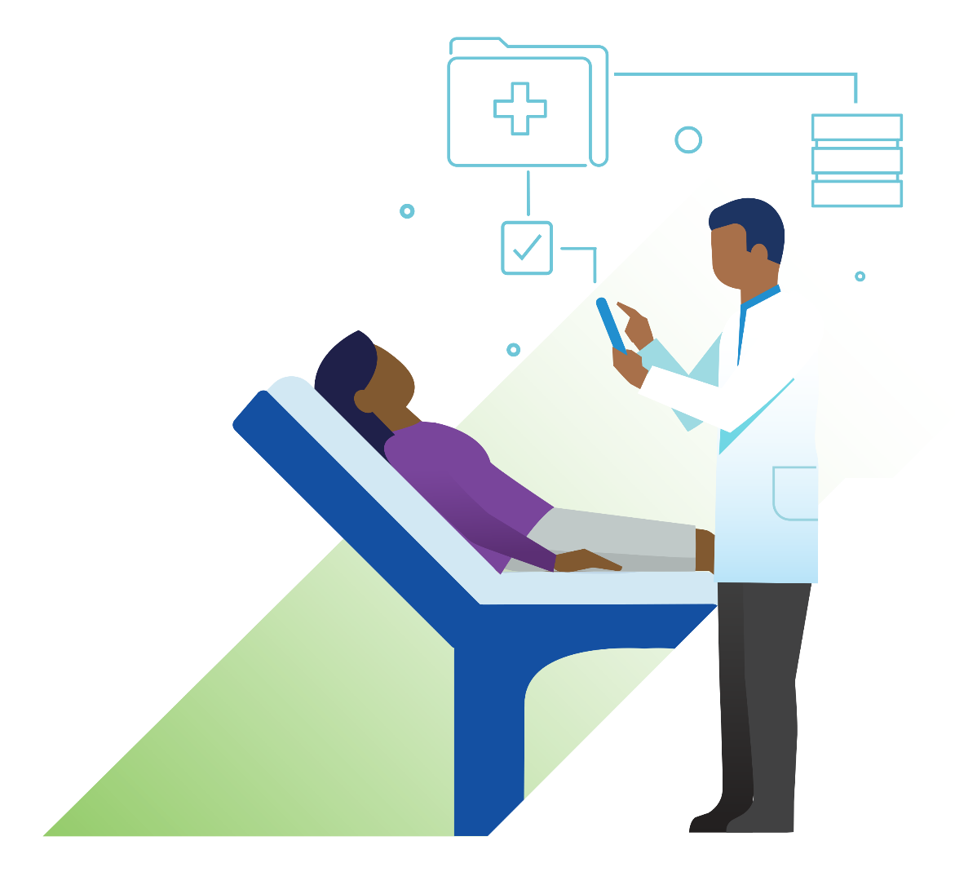
Enabling Modern Healthcare Delivery
Empower the hybrid workforce
Deliver an anywhere point of care
Advance telehealth and digital care services
Create engaging inpatient digital experiences
Notes:
Let’s just recap and discuss how these projects are being enacted in your organization

Slide 22
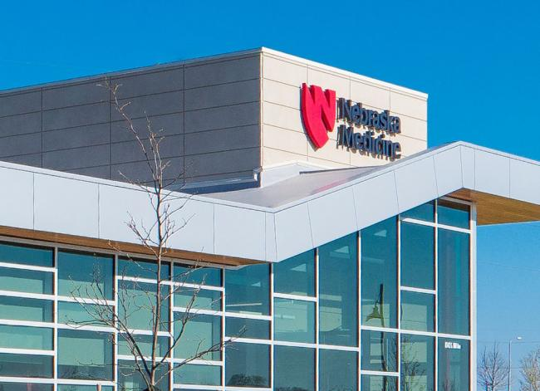
Empowered virtual care through bedside tablets during pandemic saving exposure to clinicians and PPE
Empowered clinicians working remotely through BYO support
Delivered $30 Million ROI by revamping EMR and infrastructure
Confidential │ ©2022 VMware, Inc.
22
Notes:
Even before the Pandemic, Nebraska Health was working with VMware to improve its clinician’s productivity and patient experience. That accelerated during COVID-19.
Within the hospital, VMware solutions have helped to:
Power virtual care during the pandemic, saving PPE and exposure to clinicians ​
Empower clinicians working remotely through BYO support ​
Delivered $30 million ROI by revamping EMR and infrastructure
Nebraska Medical Center
VMware vCloud Suite Enterprise VMware vSphere VMware vRealize Automation VMware vRealize Operations
VMware NSX
VMware vRealize Network Insight
VMware Workspace ONE, powered by AirWatch
**********************************
Customer Overview:
Nebraska Medicine and its research and education partner, the University of Nebraska Medical Center (UNMC), are focused on creating a healthy future for all individuals and communities in the state. Even before the two organizations merged their IT departments in 2016, they shared a mutual vision of using technology to transform the lives of Nebraskans with more proactive, preventative care. To achieve their strategic vision for cloud, security, and mobility, Nebraska Medicine and UNMC turned to a software-defined data center (SDDC) based on VMware.
Nebraska Medicine is the most esteemed academic health system in the Omaha region, with 809 licensed beds at its two hospitals, more than 8,000 employees and 1,000 physicians, and 40 specialty and primary care clinics.
Key Challenges:
Provide top-quality healthcare at the lowest possible cost
Transform data security and enhance regulatory compliance
Improve efficiency of electronic medical records (EMR) environment
Empower mobile clinicians and support more secure BYOD
Solution:
Nebraska Medicine embarked on a multi-year journey to a software- defined data center (SDDC) with the goal of enabling IT to work together more closely with the business and clinicians. With VMware solutions such as vRealize® Suite, VMware NSX®, vRealize Network Insight, and Workspace ONETM, powered by VMware AirWatch® technology, Nebraska Medicine improved effciency, reduced costs, and is providing higher quality, more proactive healthcare.
Benefits
Delivering excellent healthcare with a greater emphasis on preventative care
Enhancing network security to protect patient data and strengthen HIPAA compliance
Reduced open ports in EMR environment by 95%, helping to deliver $30 million ROI
Improving patient experiences with clinical mobility and bedside tablets
More Information: https://rv.roinnovation.com/VMWare/x/?2047785635914ce88de98a4b2740bd9f

Slide 23
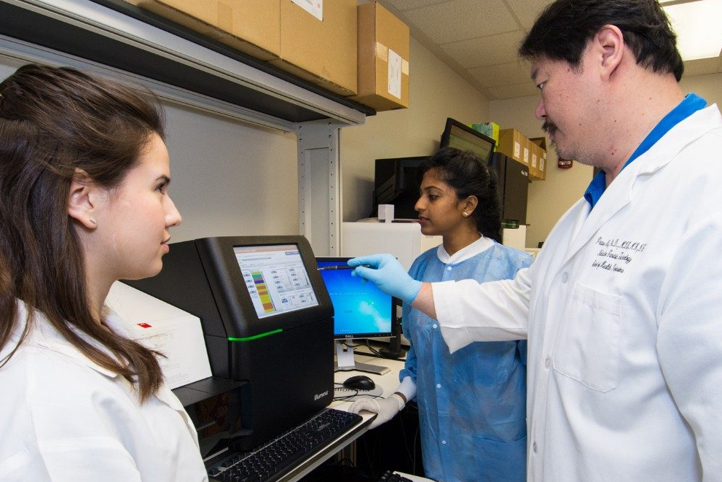
We partnered with VMware specifically for its SD-WAN solution to extend the same level of user experience to the home as if our employees were working onsite.
Quote source
Confidential │ ©2022 VMware, Inc.
23
Notes:
The VMware SD-WAN™ by VeloCloud® rollout occurred over the summer of 2019 to support more than 200 remote offices. With VMware SD-WAN, physicians were able to increase the number of scans per day, consistently increasing diagnostic efficiency for their critical patients. This not only allowed patients to get information faster, it also decreased the hospital’s time to billing.

Slide 24
Deliver Cloud Native Digital Patient Engagement
Notes:
Finally, lets look at maybe the most emerging space, that of digital patient engagement and experience

Slide 25
The Changing Landscape of Digital Healthcare
93%
are pursuing app modernization in the first half of 2022¹
61%
growth in healthcare apps deployed to public cloud by 2025²
43%
see modern apps as an accelerator of innovation³
52%
report overstretched IT as a significant challenge to app modernization⁴
1 VMware FY22 Q4 Executive Pulse
2 VMware FY22 Q4 Executive Pulse 3 Forbes CIO Survey
3 Forbes CIO Survey
Notes:
One of the biggest changes we have have seen is the acceleration of digital patient experience and engagement. As we discussed earlier, funding, reimbursement and legislation have all played their part in bringing this to the forefront of a modern healthcare strategy as did healthcare’s need to be able to deliver care in a time of crisis.
Patient portal’s have been one of the most visible examples of digital patient experience. Many organizations took the portal offerings that were available – such as MyChart. But if you and your competitor on the other side of town offer the same patient experience, how can you gain a competitive advantage? That’s the discussion we having with many organizations today with the development of new apps for patient engagement and treatment becoming critical to the business strategy.
The research shows us that the move to modern apps is a priority, but so is an over-stretched IT organization challenged to adopt new technologies
So will we see healthcare organizations starting to build out software development departments as we’ve seen in so many other industries?
How would you summarize your digital engagement strategy priorities for the next 1 to 3 years?

Slide 26
Digital Engagement Challenges
Adopting or customizing 3rd party software
Integrating with existing and emerging data sources
New patient monitoring and engagement opportunities
Notes:
Immediate challenges that we are seeing in organizations is the initial onboarding or customizing of 3rd party software. This inevitably requires integration with existing systems and in the US has the added pressures of the CURES act requiring organizations to share patient information securely
Next integrating applications with existing and emerging data sources – like remote patient monitoring information for example.
And finally the move to hospital at home, to remote patient monitoring and digital therapeutics. The first stages of personalized medicine.

Slide 27
VMware Solutions
Build, run and manage modern apps at scale across clouds
Cloud native modern app platform
Centralized operations across private, public and edge clouds
Integrate security, optimize cost, and boost reliability
Notes:
Vmware offers a complete modern application development platform…
First, we quickly allow you to set up any Kubernetes environment across any cloud, set the security and deployment policies in one place and monitor the application runtime to make sure they perform as specified,
The second part is about giving your developer a single pipeline, an environment that automatically builds the application by pulling all the open source code that is needed and makinge sure it's compliant. One development environment, one pipeline and then we give operations a way to scale on this application gets deployed across multiple clouds.
Now we have all these pieces of code running in the cloud, exposing APIs that can be used by multiple applications. We need to make sure those APIs are secure, that the communication is encrypted and with our application Tanzu enterprise, we give you all these capabilities, so that you can insert security, from the development, to the deployment, all the way to the runtime.

Slide 28
Lead New Digital Patient Initiatives
Delivering a digital first strategy for patient experience
Own the digital patient experience
Integrate data and apps – power research and interoperability
Support remote patient monitoring and digital therapeutics initiatives
Notes:
Can you discuss your priorities and strategy for digital patient engagement? Do you see your organization hiring developers or working with partner organizations? Where do you see RPM and DTX in 1 to 3 years?

Slide 29
Humana Implemented VMware Tanzu solutions to build and expand their digital enrollment platform to optimize quality.
Through their engagement with the Tanzu Labs team and with the launch of their new application, Humana has increased conversion rates year over year and now can detect, diagnose, and repair production issues in minutes, rather than days.
Watch Humana’s story on YouTube
Confidential │ ©2022 VMware, Inc.
29

Slide 30
VMware in Healthcare
35 of the world’s top 40 hospitals run VMware
#1 Infrastructure Software
#1 Mobile Device Management
94% of EPIC customers run VMware (>1000 beds)
#1 Desktop Virtualization
Notes:
Healthcare runs on VMware today. We have a long history of partnering with providers and healthcare ISV’s to ensure always-on service delivery for healthcare
According to Definitive Healthcare, VMware is the no.1 infrastructure vendor, #1 Mobile Device Management – unified endpoint management provider and the number one deployed virtual desktop solution

Slide 31
VMware accelerates innovation and makes modernization goals a reality
We run your most critical healthcare applications
We connect your providers and patients to improve care delivery
We have tools and solutions to realize your cloud and application vision
Notes:
Demands are always changing, and your business has had to adjust — to meet new challenges, requirements, and expectations
What's unique about working with VMware as you consider how to accelerate your modernization efforts is:
1. We already work together, and have for years — running and managing your applications. That's a head start on modernization because we have a deep understanding of your environment already and tools to do even more in terms of mapping application dependencies and performing in-depth analysis.
2. We have a unique patient to provider platform that can deliver innovation to improve visibility, access and outcomes
3. We have the solutions to realize your innovation goals, to utilize the right cloud for the right task, to securely extend access to providers and staff and with the services and expertise to support you on the path to success.

Slide 32
VMware Simplifies the Path to Cloud Innovation
VMware Cross-Cloud Services
Modernize HIT through Cloud Transformation
Empower Connected Care and the Hybrid Workforce
Accelerate Cloud Native Digital Patient Experiences
Cloud Infrastructure
Run enterprise workloads anywhere
Cloud Management
Automate and optimize apps and clouds
Digital Workplace
Secure access to any app on any device
Security & Networking
Connect and secure apps and clouds
App Platform
Build and operate native apps
Notes:
VMware’s strategy is to deliver a platform for innovation – building on the trusted infrastructure you run now
We look forward to partnering with you on your important initiatives and delivering the platform for your digital healthcare innovation

Slide 34
Digital transformation has allowed us to provide virtual interactions with admitted patients, reducing exposure to our providers and saving PPE.”
Brian Lancaster VP, Information Technology Nebraska Medicine
Confidential │ ©2022 VMware, Inc.
34
Notes:
Customers that invested heavily in digital transformation before the pandemic, were well prepared to meet the agility and unique healthcare delivery demands. Nebraska Medicine was able to go virtual, almost overnight, and keep their care providers safe, while caring for patients at a distance, and as a result saving previous PPE equipment for the physical encounters that needed it most. Without their investments in agile, flexible infrastructure and mobility, this transition would not have been the same.

Slide 35
Supported new services for telehealth, pop-up testing sites and mass vaccination
Successfully scaled Epic capacity up 18,000 concurrent sessions with performance close to 100% uptime
$1 million in savings from reduced support and operations costs
Powered By: VMware Digital Workspace
Confidential │ ©2022 VMware, Inc.
35
Notes:
As an example of agility, during the pandemic when a surge in patient demands and digital demands of virtual patient encounters was at its peak, Sentara was able to scale up its users on their EHR with excellent performance and uptime. As a result, they were able to deliver new services, like telehealth, and testing capabilities, and are currently setting up mass vaccination sites to support their communities. They also realized an amazing ROI of over $1M dollars from operational excellence.

Slide 36
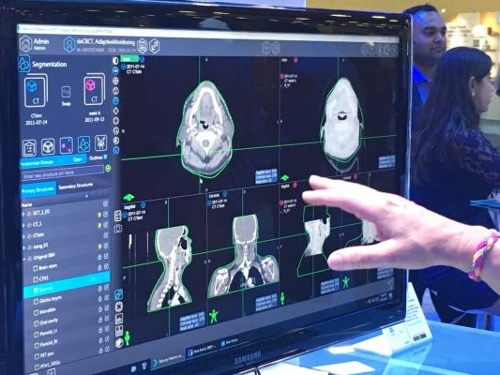
Empowered remote care for high-risk cancer patients unable to visit traditional care site during COVID-19
Enabled remote radiologists to increase volume of scans analyzed per day through increased bandwidth and optimized network traffic delivery
Confidential │ ©2022 VMware, Inc.
36
Notes:
https://blogs.vmware.com/velocloud/2020/06/17/using-sd-wan-to-connect-radiologists-and-healthcare-workers-to-their-patients/
Beginning in 2019, MD Anderson partnered with VeloCloud, now part of VMware and Dell Technologies to deploy SD-WAN across its entire existing network. VMware SD-WAN™ by VeloCloud® enabled radiologists to diagnose their most critical patients more efficiently from remote offices. Increased bandwidth and optimized network traffic delivery helped them increase the number of scans they analyzed per day.
When COVID-19 forced radiologists and other physicians to work from home, MD Anderson decided to expand SD-WAN into their homes to ensure they continued to have the same experience as if they were in the office. Very quickly, the VMware SD-WAN team deployed 500 units to radiologists to use in their homes. Soon another 500 were deployed to additional work-from-home care workers—even before VMware received an official purchase order.

Slide 37
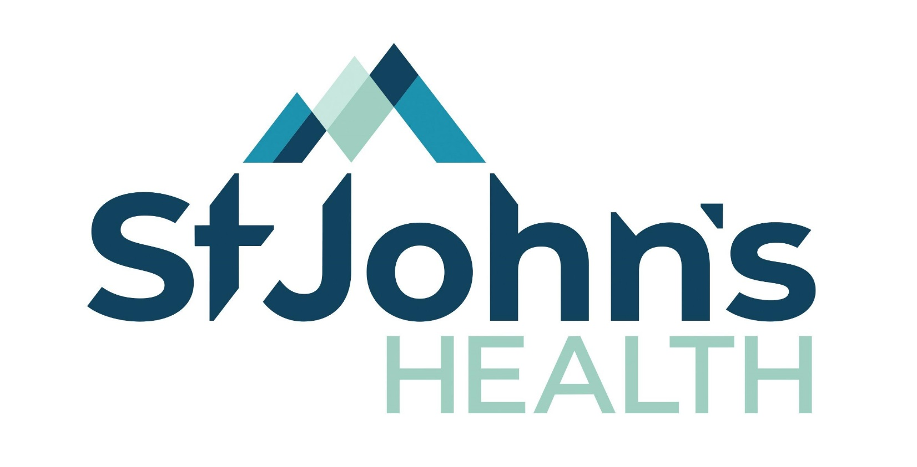
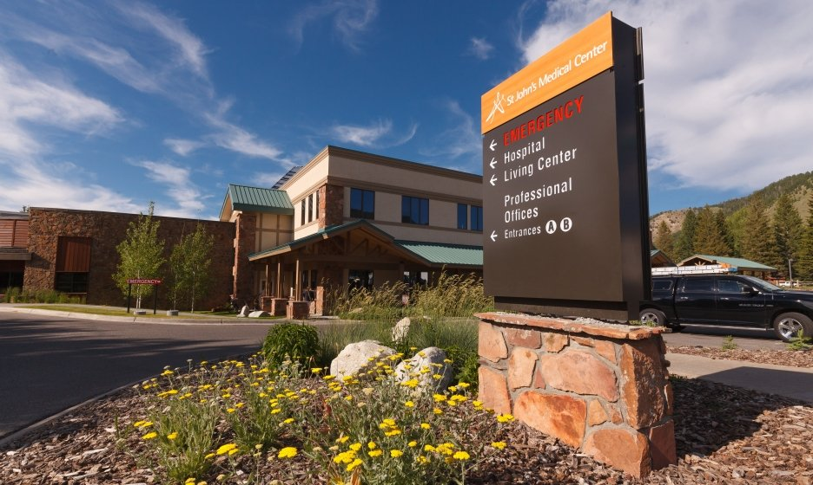
Improved patient outcomes through allowing clinical staff to access critical applications from anywhere, across any device
Increased provider satisfaction through employee-first culture increasingly remote workforce
Improved clinician efficiency by reducing login times by 138%
Confidential │ ©2022 VMware, Inc.
37
Notes:
https://www.youtube.com/watch?v=8FS_po8wm4U
https://www.beckershospitalreview.com/consumerism/the-best-it-investment-st-john-s-health-has-made-and-how-it-can-improve-the-patient-experience.html

Slide 38
VMware’s Award-Winning Ecosystem
20,000+
Partner Resellers
Technology Partners
Extend the VMware Solution set with best of breed technology options
Partner Resellers
Enabled to assist in the architecture of the data center, cloud, and edge technologies
Service Provider Partners
Deliver a multi-cloud solution, to account for the needs of your business
Jointly with VMware
Direct to Customer
1,100+
Technology Partners
Preferred Partner Services
4,000+
Service Providers
Born in the Cloud
Global SISO
Solution Partner
Managed Services Provider
Technology and IP
Corporate
Reseller
Strategic ISV
Solutions and Products
Services
Telco
OEM
Technology Alliance Partner
Horizontal ISV
Notes:
We have a very large community and ecosystem of partners to help you on this journey
Over 1100 Technology Partners – to help complete your industry specific solutions
20,000 Resellers – experts in designing data center, private, public and edge cloud architectures to suit your businesses needs
And over 4000 Service providers – for multi cloud and hosted solutions needs

Slide 40
VMware Healthcare Customers
Notes:
About 10 years ago, when hospitals were moving from paper-based systems to electronic medical records, VMware became the common infrastructure organizations used to run their hospitals. Today, many of the largest health systems rely on Vmware to provide patient care. This next wave of transformation Is however, unlike anything healthcare has experienced before.

Slide 41
Challenges of Today’s Distributed Work Environment
Hybrid is enabling new hiring and retention opportunities
61%
of healthcare executives expect their hybrid workforce to grow in 2022¹
71%
agree that risks related to security and privacy are challenges in delivering work-from-home capabilities²
63%
would lose significant employees without hybrid work practices³
38X
increased telehealth vs pre-COVID levels (July 2021)⁴
1. 1 VMware FY22 Q4 Executive Pulse
2. Forbes CIO Survey
3. Forbes CIO Survey
4. McKinsey July 2021
Notes:
We’ve been getting used to the distributed work world for two years now, and hybrid is normal now. However, security and legacy technology are getting in the way of experience. Broadly, the challenges are in three buckets.
[Build 1] The first set of challenges is sub-optimal experience. Users are still struggling with poor network performance and using overloaded VPNs over their home internet connection. They have even more apps to connect to that are all over the place, and when they need help, all support has to be remote. In our research, 80% of the people we surveyed agree that companies must do a good job at supporting remote work to be competitive
[Build 2] The second set of challenges come from fragmented security. With resources and users all over the place, the old on-prem network perimeter-based security model is just ineffective much of the time now. And 64% of our survey group says that security gets in the way of productivity.
[Build 3] The last bucket is operation complexity. The patchwork of tools for both management and security just keeps growing, making everything more expensive and complex. Companies always want better ROI, and IT teams want better visibility. Just about everyone agrees that this is going to be a challenging problem this year.

