Slide 1
Defense Application Framework
Delivering Digital Sovereignty
Michael Crowley
EMEA Director Public Sector
June 2019
mcrowley@vmware.com
Mob : +33 6 7993 1962

Slide 2
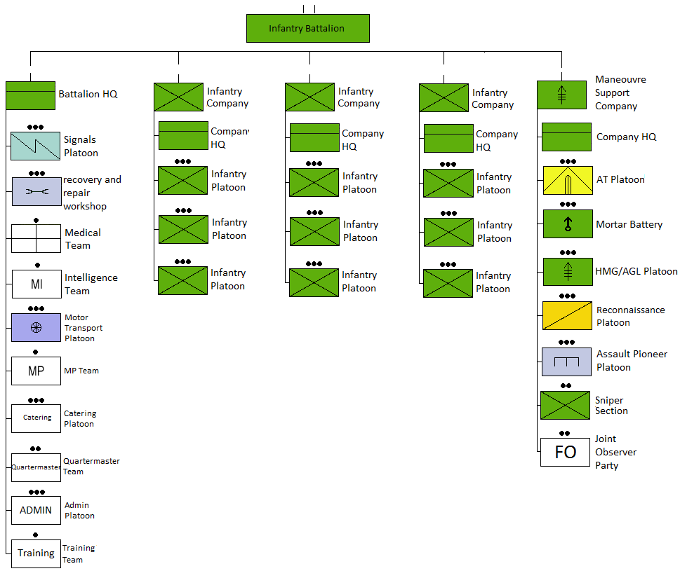
A traditional hierarchical organisation : be self sustainable
JOINT LAND AIR SEA HQ
ARMY HQ
Division HQ
2-3 Brigades
10 – 20000 h
Brigade HQ
3-5 Battalion or Regiment
3 – 8000 h
BRANCHES
Mélé : Infantry, Armoured, Engineers, Artillery
Direct support : Artillery, Engineers, NBC, Medical
Support : Logistics, Materiel, Life support
Each branch has its own Control & Command application
Organic vs non organic resources from the upper echelon

Slide 3
Defense Application Landspace Land Air Sea
Historic
Implementation
time scale
Back Office
ERPs
HR, Purchasing, Payroll
Home Logistics
Spare Parts
Life Support
Operational Domain
Bi and multi lateral partners
NATO, EU
International Organisations
Coalitions missions; Ad Hoc & Long Term
5-10 Yrs
Operational Systems
Customed Developed
Discrete Land, Air, Sea
Command & Control
Projection
10-15 Years
Weapon Systems
Customed Developped
Untrusted sources of information
Trusted sources of information

Slide 4
The Defense Application Framework – Stove Pipes
Collect
STRATEGIC
POLITICAL DECISIONS
JOINT FORCES LAND, AIR, SEA
COMMANDS LAND, SEA, AIR
Situation
Decide
Execute
OPERATIVE
LARGE MULTI BRANCH UNIT
BRIGADE/DIVISION, CORPS
EXECUTED COORDINATION
Effect
TACTICAL
SPECIALISED ELEMENTARY UNIT
REGIMENT, BATTALLION
Iogistics
Armoured
Infantry
Medical
Engineers
Life support
Materiel
Artillery

Slide 5
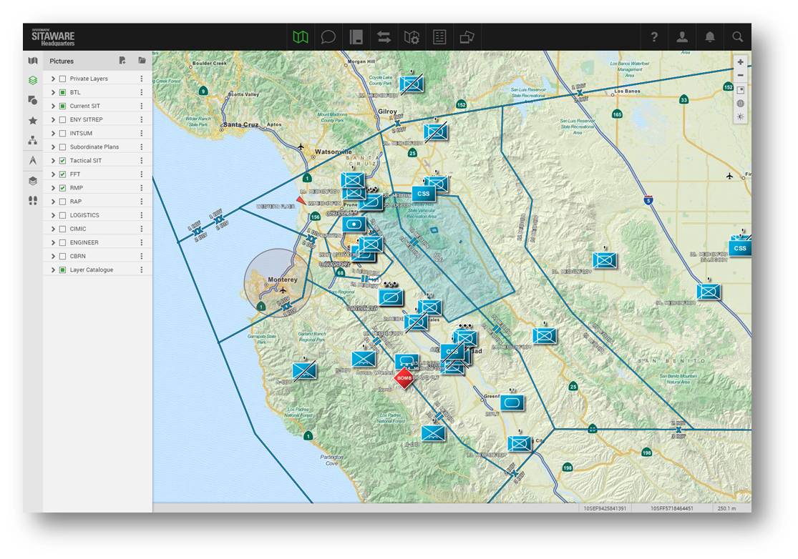
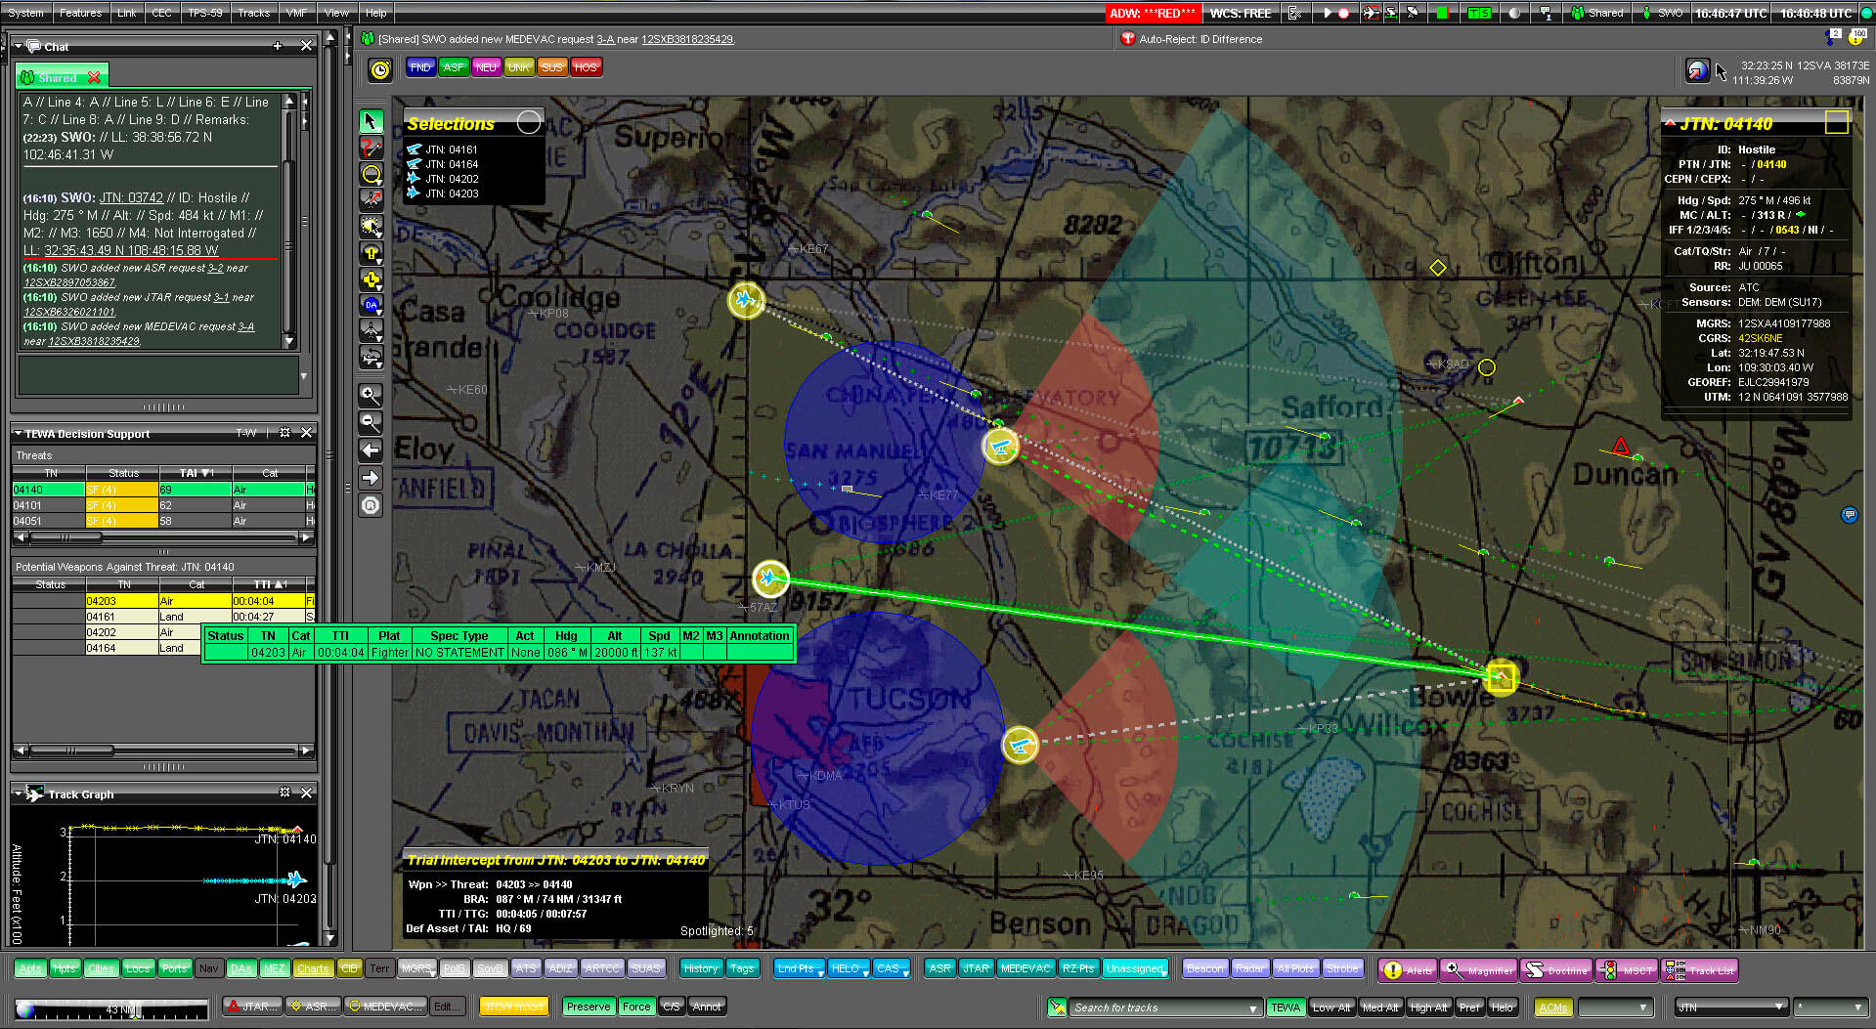
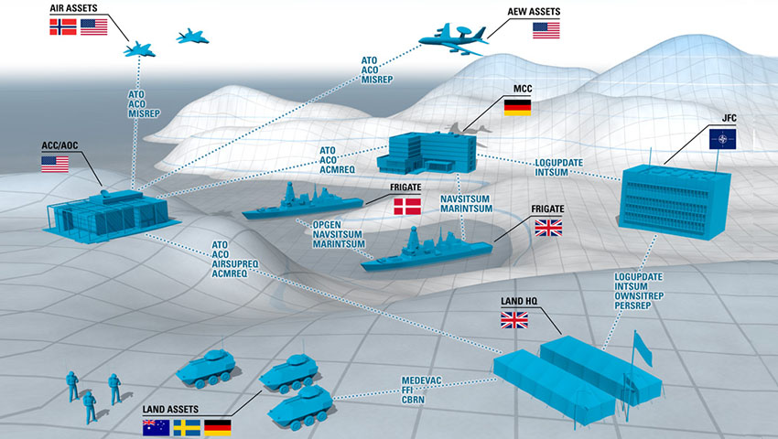
Defense operational applications characteristics

Slide 6



CHANGING WORLD – APPLICATIONS ALIGNMENT ?
1980s
Traditional organization
For a central European
48 Hours conflict
1988
Is the world now safe ?
1990s
International light multi
branch long term missions
in a coalition environment
1991
Desert Storm
Coalition over 500 K pers
2018
US 3rd balancing strategy
2018
Cyber an operational command
US 2nd balancing strategy
2000s
International projection with
long term engagement
Face asymmetric and
symmetric threats
2014
Resurgence of Central European Threat
NATO Federated Mission Networking
Terrorism
Afghanistan 2003
130000 – 17000 pers
39 nations
Ebola Crisis
Projection & geo control
Hybrid war / peace
ISIS 2014
12 Nations

Slide 7
The Next Generation of Control and Command Applications
The pace of modernisation delivering adapted capabilitlies is a country strategic advantage
  Leverage COTS and technologies from the market (NATO ACT 2015)
  Combination of civil technology and military systems
  Threats have a continued access to market innovations
Operate both in Peace and War conditions : hybrid warfare
  Adaptability and flexibility to changing situations
  Small signals, asymmetric threats
  Collect and process information from trusted and un trusted sources
Cyber integrated throughout
Federated Mission Networking
  Coalition is the norm : operational interoperability
  From stove pipes to collaborative models and loosely coupled networks
Coordination with Humanitarian Organisations

Slide 9
The Defense Market
Market Drivers
Rapid rate of social, economic, scientific, technological and environmental change
Evolving threats, including cyber and urban warfare, major conflicts in the Middle East and Africa, and growing concerns over Russia, China
Transition of modern warfare from battlegrounds to networks and cyber space
Economic pressures on national budgets and high fiscal deficits
Coalition operations
$112B
Market Needs
Interoperability and agility across Command and Control (C3) Systems
Rapid data collection and dissemination across Coalition member networks and from multiple sources
Investments in IT infrastructure, equipment modernization, and cyber defense
Mobile access to data
Continuity of operations, conflict resolution
Notes:
The 15 largest spenders on military account for $1,360 billion, or 81%, of total global military spending.

Slide 10
Federate - Share - Win
Connecting
Plug-and-Play
Federation of Clouds
Big Data
Global Information Sphere
Orders
Situational
Awareness
Observations
Data Elements
Value-added
Information
Situational
Awareness
Decisions
Plans, Orders
Sensing
Processing
Sense-making
Deciding
Effecting
Collecting
Decision Making
Effecting
Notes:
MC: ** This slide is issued from NATO unclassified deck. Our vision and solution portfolio is fully aligned with NATO. Please note a NATO representative will be attending. **
The slide illustrates the process of collecting information from any source, from HQ intelligence systems to sensors in the field delivering a situational picture for decisions and operational orders in the field. The Cloud enables this process as a streamlined communication connecting real time all stakeholders.
To illustrated a few use cases; Please note as of today no Defense organization has delivered the full functional architecture.
Swedish Defense;
secured deployment of Control, Command and Communication systems (C3) – vSAN, NSX
UK Mod;
BAE will speak to that – deployment of secured C3 systems, with built-in redundancy for battleships.
US DISA Multi-national Information Sharing (MNIS) Program:
VMW stack formed the basis of the Virtual Data Center (VDC) deployed to support service capabilities that allow the facilitation of information sharing among DOD components and eligible foreign nations in support of planning and execution of military operations.
US TDC-Theatre Deployable Communications:
VMware is providing a portable SDDC which is comprised of vSAN (virtual storage) and vSphere (virtual compute). Lightweight and compact kits for the warfighter who is forward deployed on the ground.

Slide 11
VMware Vision
ANY DEVICE
ANY APPLICATION
Traditional
Cloud Native
SaaS
ANY CLOUD
Notes:
Driving Alignment: Customer Strategic Priorities and VMW Vision
--Always start with the customer strategic IT priorities – 4 areas of priority for the IT teams we serve...
--Tight alignment between customer priorities and VMW vision

Slide 12
Virtualisation and Segmenting C3 systems - UK
Enabling Federated Mission Networking

