Slide 1
Deliver Patient-Centric Care from Anywhere with VMware SASE
Brady Kachapuram
Senior Product Marketing Manager
April 2022
Notes:
Intro and thank you for the business … I heard a lot of great stories about how you all made it possible for hospitals to deliver care during challenging time last two years
This is just the beginning and we have huge opportunity ahead of us….

Slide 2
State of Healthcare
Challenges
VMware SASE
Healthcare Usecases
Outcomes
Case Study

Slide 3

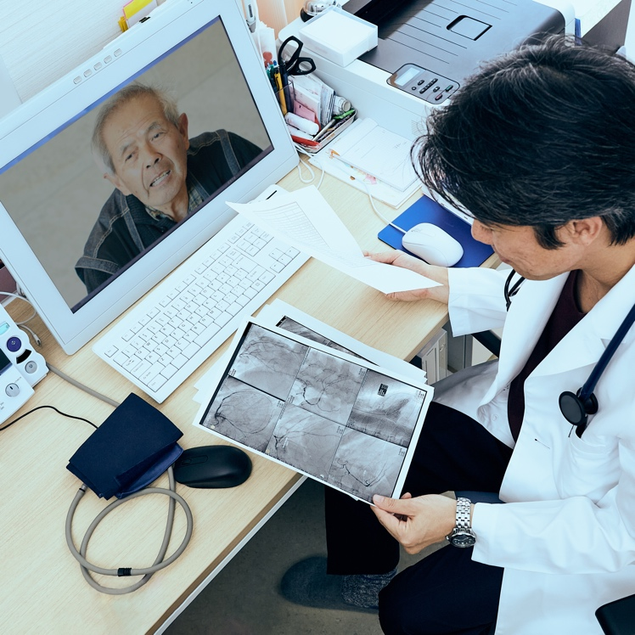
Every Aspect of Healthcare Has Changed
Patient
Staff
82% of consumers
want digital options to monitor health*
61% of workers
want hybrid work approach post-pandemic*
*Mckinsey COVID-19 Consumer Survey April 27, 2020 (link)
*Enboy & Wakefield Reearch Study on Remote Work N=1000 US Workers February 2021 (link)
***
Notes:
Over the last two years, healthcare has transformed the most and Every Aspect of it has changed
Patient preference changed – with Virtual care now a “must have” as an option.
As a parent to a toddler son, it is much easier for get my son checked up over phone for minor ailments
Patients are expecting digital front door increasingly due to the expectations set by non-Health care organizations such as Netflix, amazon (such as mobile applications, messaging services and no-touch check-in) ----- which means healthcare organizations need to deliver great digital experiences….
Work from anywhere is here to stay - especially when it comes to non-clinical staff -as it opens new locations - given the challenging hiring environment (tie to session)

Slide 4
Hospitals have remote patient-monitoring systems*
*https://www.aha.org/telehealth
Notes:
There are increasing numbers of connected medical devices …….American Healthcare Association stated that >61% of hospitals have remote patient-monitoring systems, which means they have some IoT devices that need to be monitored. This is important not only because it creates more complexity for the IT staff, but also because it creates a greater risk. The more connected devices, the greater the attack surface. Organizations need to ensure these devices remain segmented or isolated from applications that contain sensitive or private information and are patched to avoid vulnerability. It could also mean that large imaging files or lots of small bits of information need to be transferred over the wide area network to centralized repositories in data center or cloud environments.

Slide 5




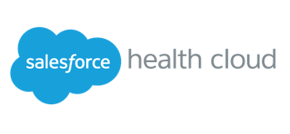




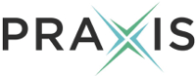


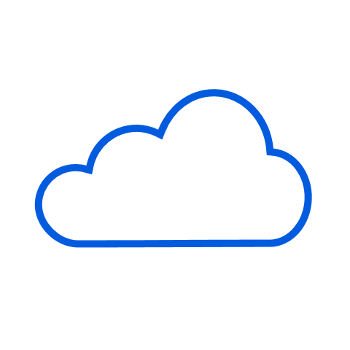




Healthcare IT Architectures Are Now Highly Distributed
DISTRIBUTED
WORKFORCE
120
80
72
DISTRIBUTED
APPS
DISTRIBUTED CLOUDS
& INFRASTRUCTURE
Data Center
Near Edge
Far Edge
A diverse, multi-cloud environment that’s only growing more complex over time
Notes:
Continuing the conversation on changes in Healthcare -> How has Healthcare IT architecture changed?
Workforce is distributed with people working across multiple hospital locations, or temporary pop-up clinics and staff working from home across the country
Distributed Apps -> healthcare is accelerating adoption of SaaS/Unified Communications as Service (with the likes of Zoom, Ring Central) based applications for increased resiliency and DR
Infrastructure to deploy these applications has becoming distributed with some applications such as EHR deployed in the data center, cloud virtual desktops for remote workers deployed in the near edge or the cloud

Slide 6

This Shifted Healthcare Organization Priorities
Deliver Digital Experiences for Patients
Support for Remote Staff
Simplify IT Operations
6
Notes:
Changes in employee and patient preferences, Iot, and the change in architecture resulted in some shift in priorities. From a stakeholder perspective,
Addressing the key stakeholder that is central to Healthcare Organizations – Patients, Meeting and exceeding patients’ expectations by rolling out digital health experiences that consumers are used to in non-healthcare settings and providing patients with the integrated experience no matter where they seek care.
Providing remote employees with similar experience, and have similar type of protection in place as the office employees
Last but not the least – making the life of IT Ops team that is working to get this delivered easy
To summarize ---- All of healthcare is impacted — patients, clinician, providers, hospitals, personal data — and the way providers care for their patients is becoming more personalized — based on specific patient needs​

Slide 7



Digital-first Healthcare is Now a Business Imperative
Hybrid Workforce
Connected Care
Virtual Care
Pop-up Clinics
Traditional Care Sites
Notes:
To meet these priorities head-on, health care orgs are turning to Digital-first Healthcare model
Two aspects of Digital-First Healthcare
Hybrid Workforce -> Hire and retaining top talent across the country
Connected Care -> Deliver easy, secure access to care and an integrated experience (w.r.t care delivery, patient portal/apps and diagnostics) for patients – no matter where they visit you – by ensuring that care givers – at a hospital, remote clinic, or a mobile clinic -- can quickly and securely access patient data and applications that are increasingly in the cloud

Slide 8






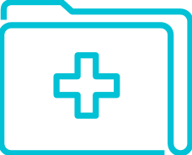
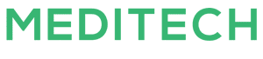




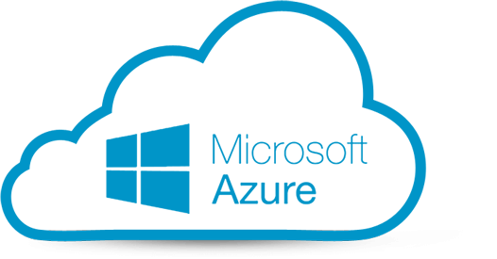


Digital-First Healthcare comes with its Challenges
How can I deliver new applications and services
Does datacenter-centric approach work?
How do I protect my data?
How can I quickly enable new care locations?
VPN
VPN
Hospital / Datacenter
DATACENTER/HQ
VPN
Can I ensure reliable user experience
VPN
Co-located Datacenter
How much do I trust this device?
Clinic
Can I provide seamless secure access
Notes:
Common issues include:
Delivering the new services and application – as we saw with telehealth, securely and effectively to new sites and users
Ensuring the technology is improving, not distracting from patient care
That patient data is secured and always-on

Slide 9

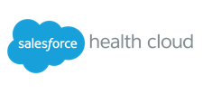













Legacy Approach: Backhauling Traffic to the Data Center
Data center-centric approach is inefficient and complex
Data Center
SaaS
Public
Cloud
Remote Users
Anywhere
Home
IT
Traffic Flow
IPSec/TLS VPN
Staff
Internet
Hospital
Traffic Flow
Clinician
Staff
Site-to-Site VPN
Patient
Private - MPLS
Hospital Users
  High Latency • High Operations Cost • Complex • Lack of Agility
Notes:
With the legacy approach, all of the traffic is backhauled to the data center. Branch offices use site-to-site VPNs and remote users come into to a VPN concentrator for gateway inspection and control. In the data center, traffic is sent through a stack of network and security appliances and then on to either applications in the data center or back out to services in the cloud.
The result is high latency, high operational costs, too much complexity, and a lack of agility. The stack of appliances lacks elasticity making it challenging to dynamically grow when the HCOs are expanding their footprint either with new locations or through M&A, which is common in healthcare and support future use cases.

Slide 10
And Legacy Technology Brings…..
X
Unproductive Remote Workers
Poor Patient Experience
Increased Risk
Complex Operations
Unreliable network and VPN scale challenges
Slow access to healthcare apps
Inconsistent access to patient data across care sites
Unable to rapidly deliver new services
9,851% Increase in Healthcare Cyber Attacks in 2020*
Complex Compliance Requirements
Limited staffing resources and knowledge gap
Siloed networking and security infrastructure increases CAPEX and OPEX
Notes:
And legacy Technology brings:
Unstable, slow connections:
It isn’t ideal if employees – be it in a remote care site/branch office or from home - using broadband experience problems connecting to the Internet and VPNs (especially in time sensitive situations). Imagine a video call with a doctor going wrong (happens often to me :P) OR a phone call with a customer service representative becoming choppy
It is also difficult to extend the same level of protection to remote workers as on-site workers.
Poor patient experience: When healthcare professionals have inconsistent access to applications and data across care sites, it is more difficult to deliver new services such as telehealth, provide amazing digital experiences and respond to the changing needs of patients. These unnecessary delays reduce the quality of care and have a negative effect on patients’ experience.
Increased risk: The distributed architecture increases the attack surface area. The evolving threat landscape makes it difficult for healthcare providers to safeguard patient data against damaging data breaches and data theft. There is also increasing pressure to meet regulatory compliance requirements such as HIPAA.
Complex IT operations: Siloed networking and security infrastructure increases costs and complexity to deploy and manage services. In addition, limited resources and skill gaps make it difficult to deliver healthcare IT services.
Bottom line – Even if you are using best services etc. unless you have infrastructure that is foundational set…

Slide 11
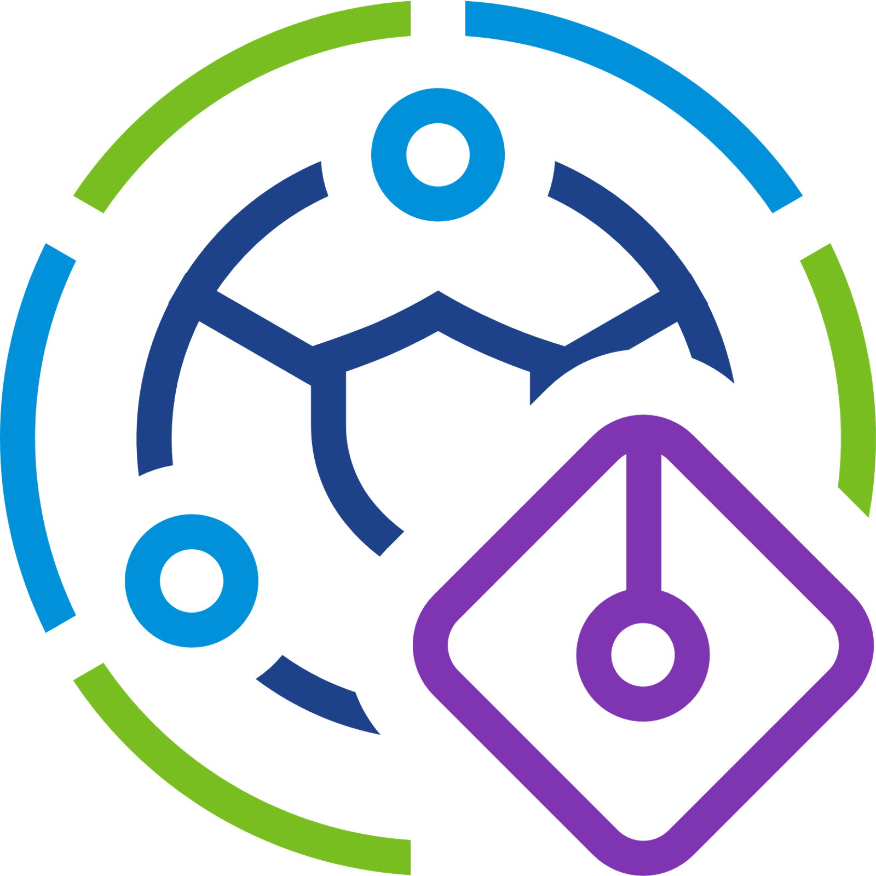




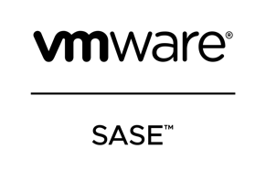

VMware SASE is foundational to Healthcare
Addressing connectivity and security needs for Digital-First Healthcare
Locations
Cloud
SaaS
Hospital
IaaS
Ambulance
Web
Apps &
Data
Home
Users
Clinician
IT
Medical
Device
Data Center/HQ
Devices
On-prem
Notes:
So far, I talked about the challenges. What does VMware do to help?
Imagine that you are in the new distributed environment, where a healthcare organization’s staff is located everywhere – hospital, remote clinic or in an ambulance; they could be doctors, or administrative staf such as receptionist, IT administrators …..in addition to workstations, there are number of medical devices that are connected to the network .
Applications and data are located in the on-premises data center, increasing in the cloud, and SaaS apps are becoming more popular.
Imagine again that VMware SASE services are sitting between these users/devices and the target applications. VMware SASE serves the user at an optimal time and from optimal locations, maximizes the performance, optimizes user experiences, and simplifies IT operations. VMware SASE delivers networking and security services at scale, while better protecting these users, workloads, and data and lowering costs. That is what VMware SASE can do.
VMware SASE – is an extensible platform with a single pass architecture that converges cloud networking and cloud security into one holistic solution delivered from VMware SASE PoP. With VMware SASE, healthcare organizations can provide your clinical and non-clinical staff with reliable, optimal, and secure access to any applications anywhere – on-premise data center, public, or SaaS.

Slide 12

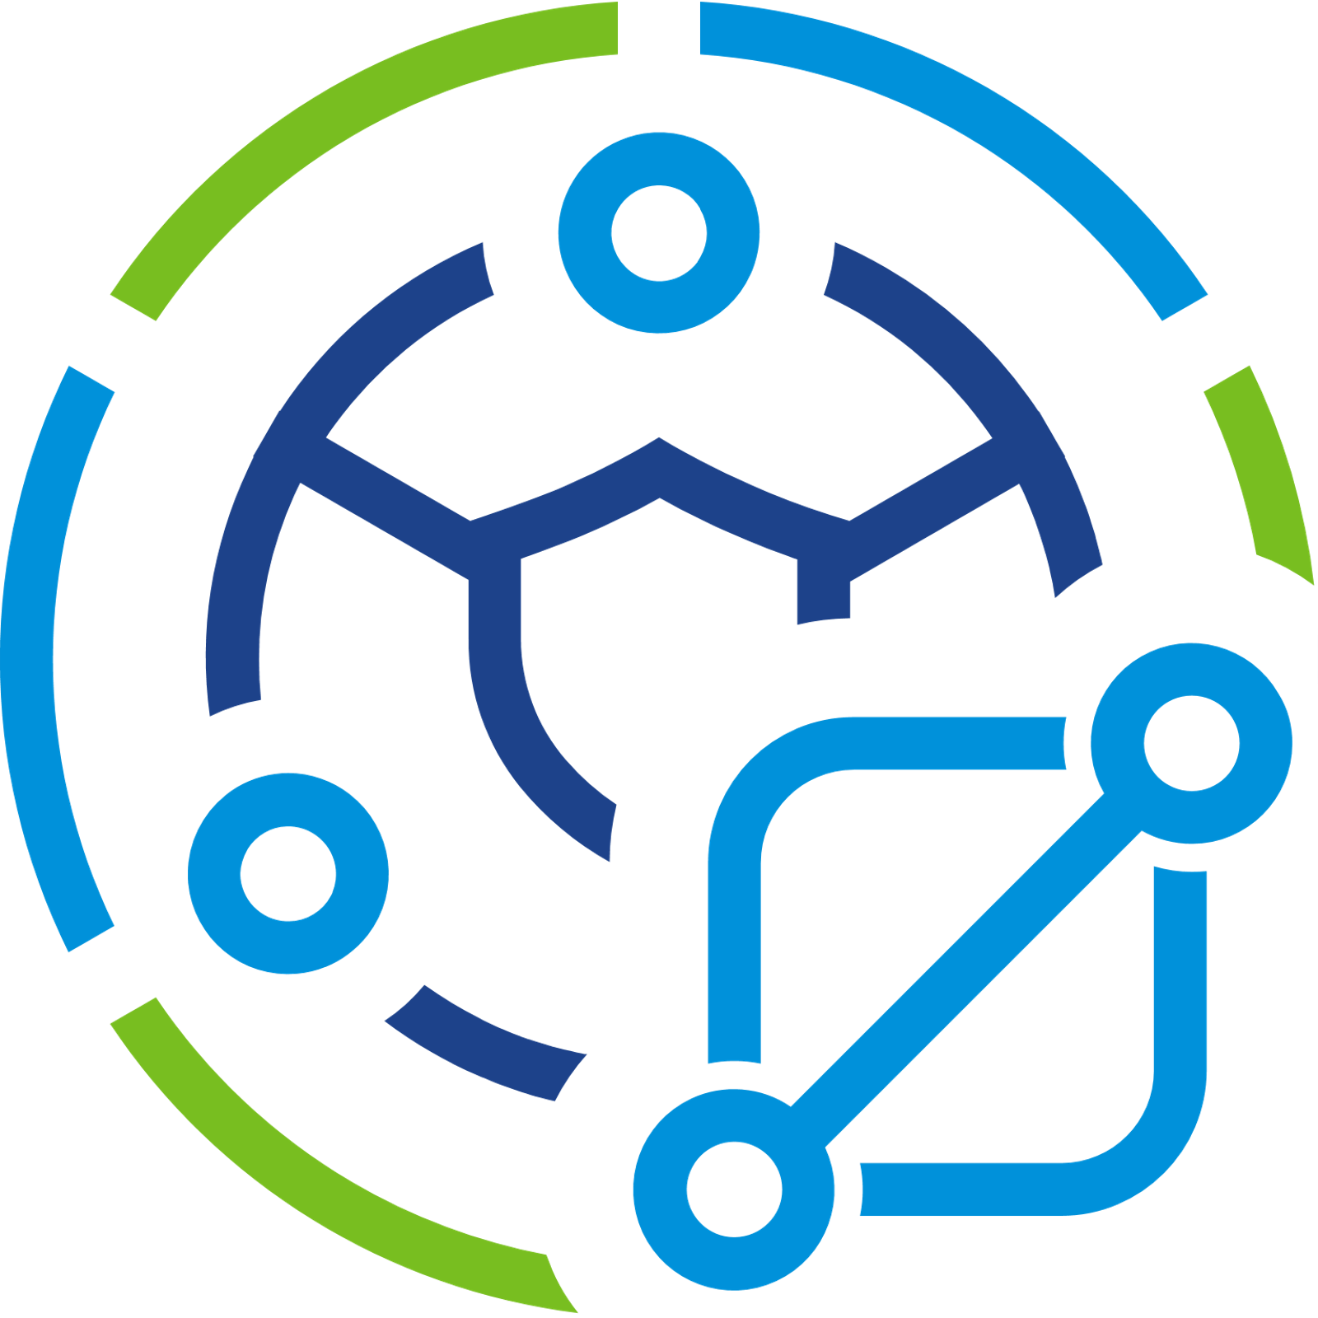
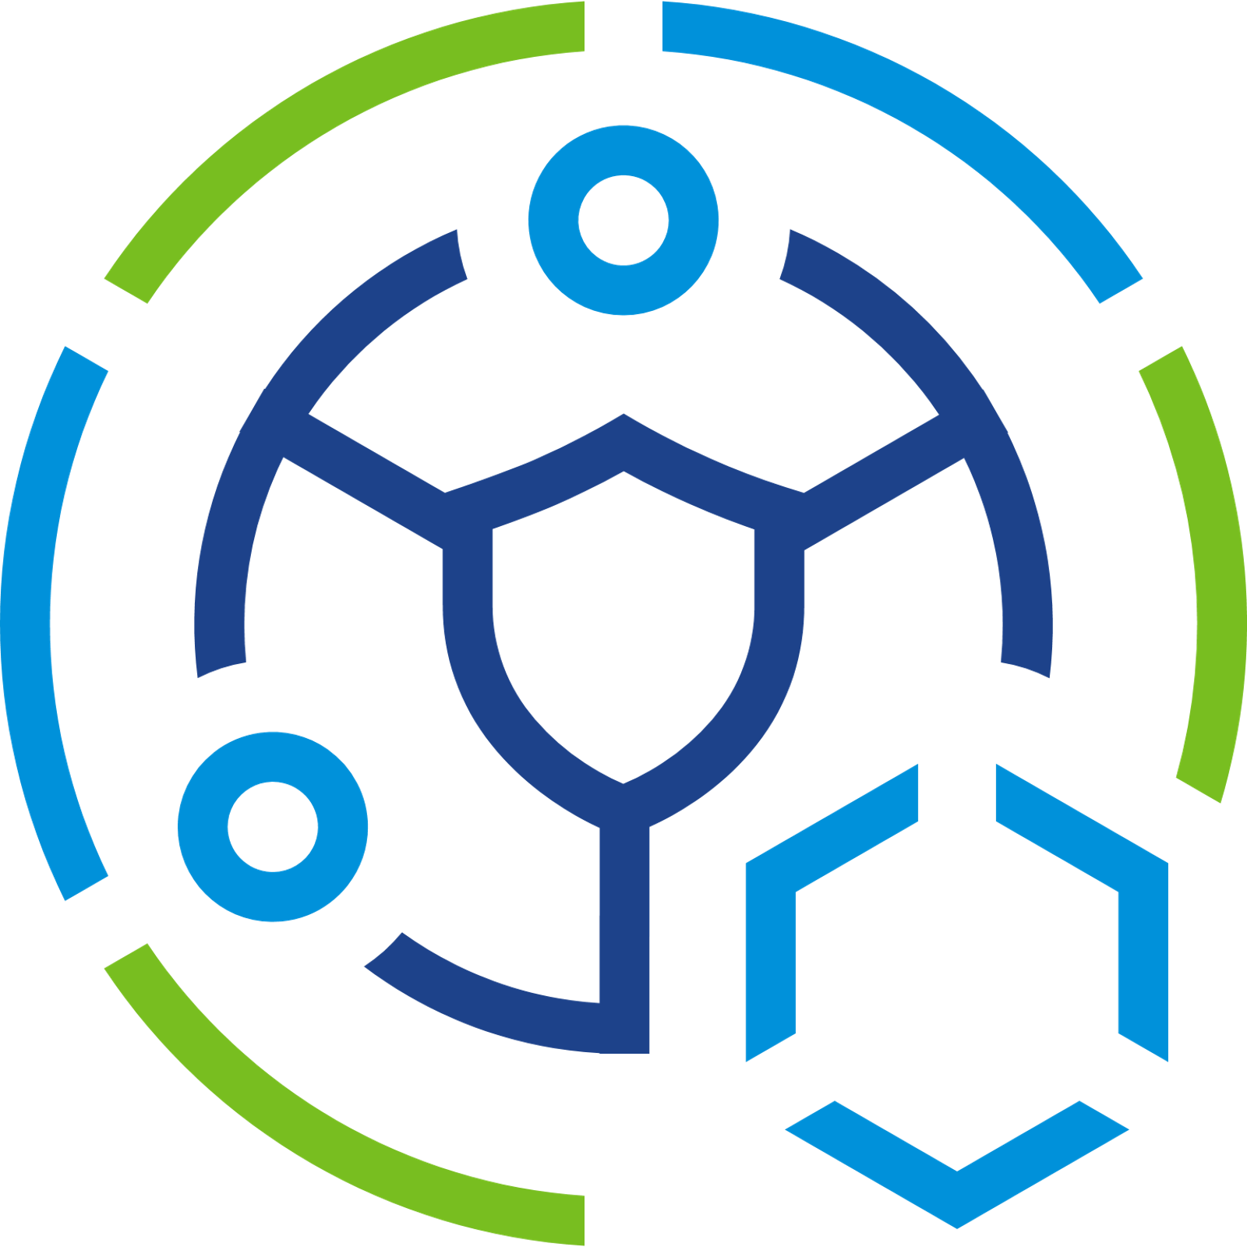
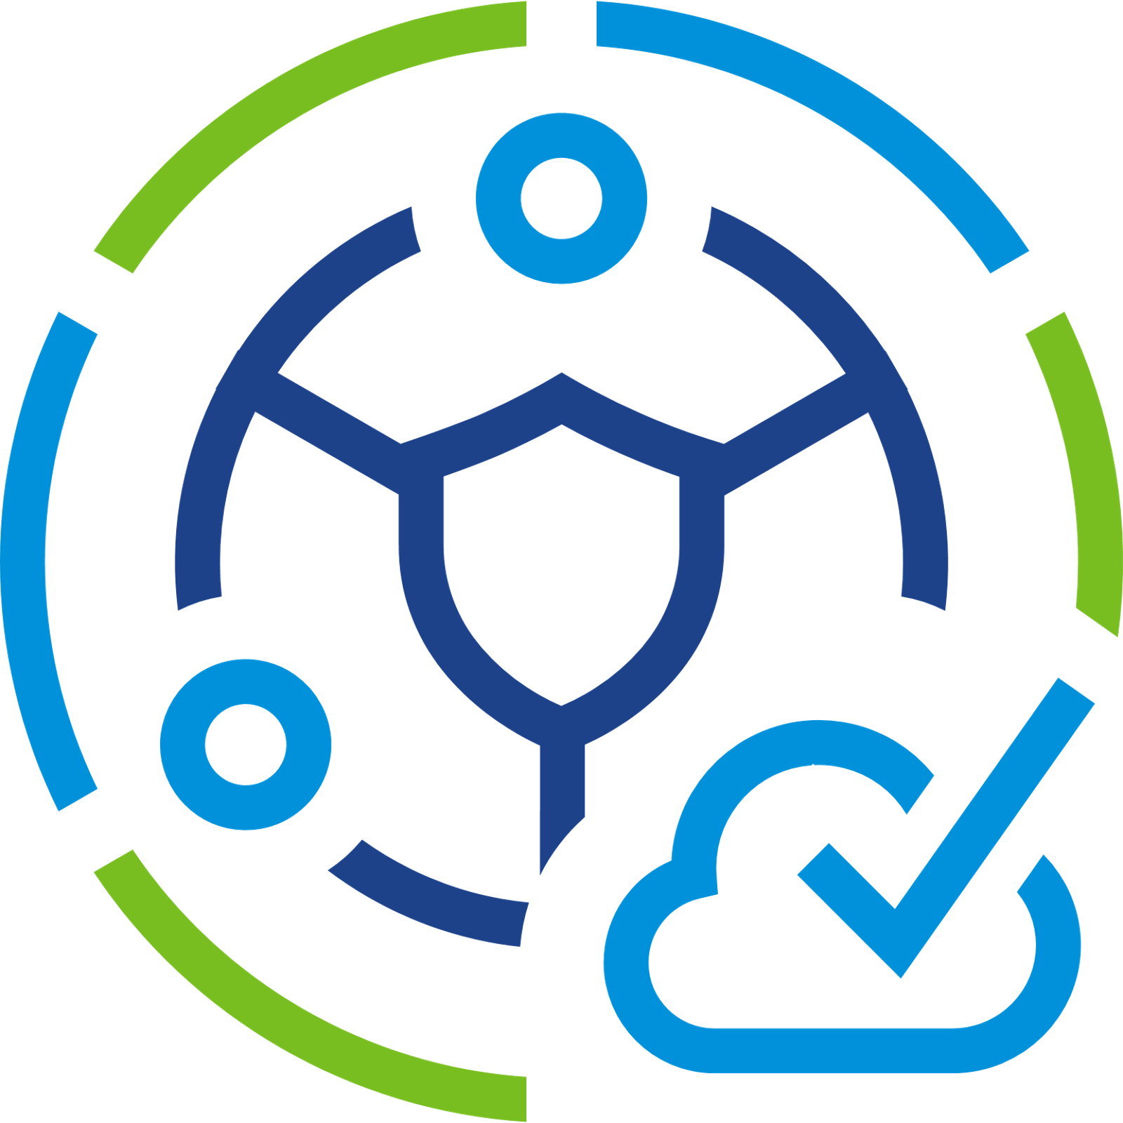
VMware SASE is foundational to Healthcare
Addressing connectivity and security needs for Digital-First Healthcare
Comprehensive Services for Healthcare Organizations
Locations
Cloud
SaaS
Hospital
VMware Edge Network Intelligence
IaaS
Ambulance
Web
Apps &
Data
Home
Users
Clinician
IT
Medical
Device
VMware SD-WAN
VMware Secure Access
VMware Cloud Web Security
Data Center/HQ
Devices
Thin
Edge
Thick
Cloud
On-prem
Notes:
VMware SASE delivers comprehensive for multi-cloud and hybrid healthcare organizations
4 key components
ENI (brains behind the SASE, makes sure the end-users and devices have the best experience)
SD-WAN (provide the performance)
Secure Access (provide context based and policy driven security to enforce zero trust network accesss)
Cloud Web Security (protect against dynamic threats)
These are all packaged into a PoP, which is present in a location closest to each of the hospital. We cover most major metropolitan areas and there is a very very high chance that you are close to a PoP

Slide 13
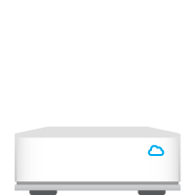

VMware SASE for the Multi-Cloud Era
User-centric approach embraces application modernization
Data Center
SaaS
Public
Cloud
Remote Users
Anywhere
Home
High-speed optimized
PoP
PoP
PoP
IT
IPSec/TLS VPN
Staff
Connect to the Cloud
Internet
Hospital
PoP
Authentication
PoP
Site-to-Site VPN
Clinician
Staff
High-speed optimized
High-speed optimized
Patient
Private - MPLS
Hospital Users
  Improved App Performance • Lower Opex • Cloud First Scale & Simplicity
Notes:
SASE shifts from a data center-centric to a user-centric approach to enable you to take advantage of application modernization.
[Click 1] We take that stack of security and networking appliances and move that functionality to a cloud Point of Presence, close to the user.
Within each PoP is a single-pass security architecture to ensure no matter the location of the user or app, your security policies are consistently enforced.
[Click 2] Users connect to the PoP, are authenticated, and have direct access SaaS services or IAS applications.
[Click 3] These PoPs are geographically dispersed and located near the on-ramps to popular SaaS services like Office 365. There are more than 150 worldwide.
[Click 4] For applications in the data center, remote or branch office users are securely connected through a combination of public networks and/or private MPLS lines with routing constantly optimized for performance and reliability.
We deliver <5 ms latency to all major cloud service providers.
[Click 5] Edge Network Intelligence provides visibility and self-healing so your applications and services are delivered with the highest quality and reliability to your users.
The result is a better user experience through improved app performance. The user-centric approach simplifies operating costs. The cloud delivery enables agility and scalability.

Slide 14
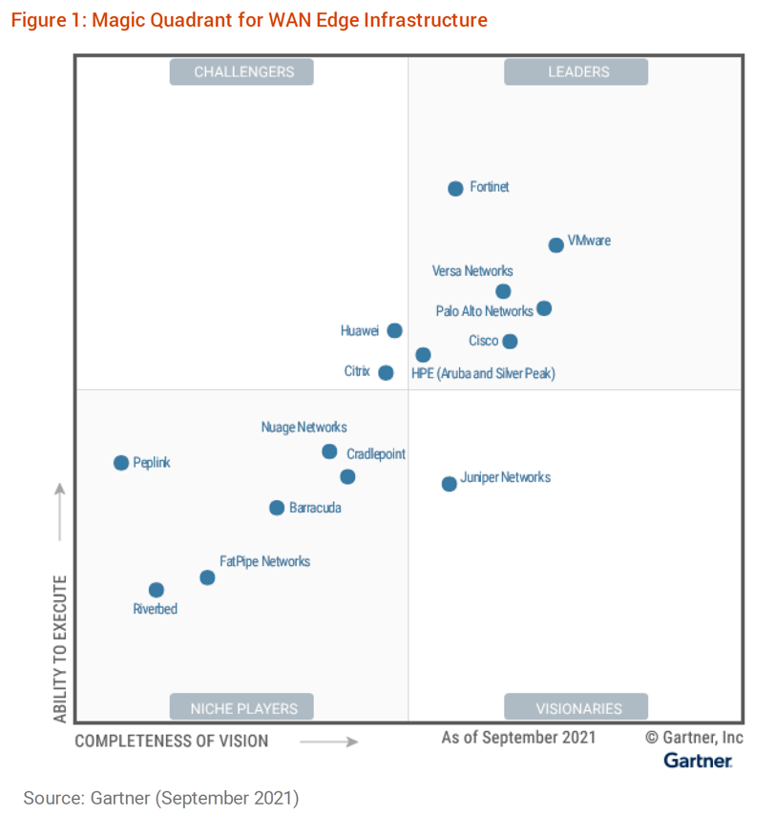

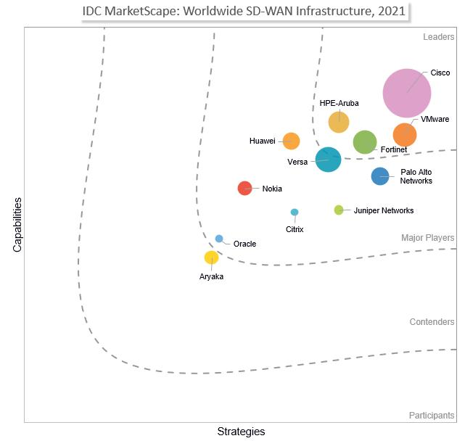
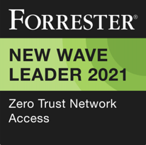


Analysts See VMware as the Leader in SD-WAN and SASE
VMware is uniquely positioned to solve the challenges for the Edge
Leader
Leader
Leader
LEADER for the fourth consecutive year
Leader based on our ability to execute
furthest for completeness of vision

Slide 15



Digital-First Healthcare Initiatives
Virtual Care / Telehealth
Work from Anywhere
Modernization
Branch networking infrastructure upgrades, Cloud Adoption
Work from home, clinic or remote site and get secure, predictable access
Secure and ubiquitous care delivered from anywhere
Security and Compliance
Client & IoT Device Experience
Remote and Mobile pop-up clinics
Enable Zero Trust Security Safeguard patient data Ensure HIPAA compliance
Proactively detect and respond to issues and secure medical IoT devices
Rapidly bring up new sites with automated operations
Notes:
We are going to look at how VMware SASE can directly help healthcare organizations can deliver Digital-First Healthcare. The legacy architectures not built to support the increasing demands of Digital-First Healthcare. There are 6 key use cases that we see our healthcare customers focusing on:
Modernization -> If you are on MPLS, you are potentially paying significantly higher money for “not good enough” performance. Look at ways you can modernize your networking and security infrastructure from a holistic perspective with SASE - and futureproof your investments. Please check out our TEI (Total Economic Impact report) to see your potential ROI
Telehealth/Telemedicine -> With bandwidth-intensive video application, , these application needs high-level of reliable bandwidth – that SASE can securely deliver
Work from Anywhere -> Deliver superior connectivity (one of my booth colleagues was saying that he is getting 10x better performance using satellite working from his parent’s house in mountains) and provide similar level of protection as you would for an employee working from office using SASE’s WFH offerings
Security and Compliance -> With distributed workforce and applications, there is an increase in attack surface. The defense in depth approach is the best way to make sure you have all your bases covered. SASE offers suite of cloud-based security offerings – to provide context-based, policy aware access; protect from malicious attacks and maintain compliance.
Edge Compute and IOT -> There are a wide variety of IoT devices ranging from a patient monitoring device to track health metrics to a smart thermostat that are now connected to the internet. Not having the ability to track and monitor these devices, can lead to security catastrophes. VMware Edge Network Intelligence tracks all your IoT devices, establishes a baseline on patterns and performance – remediates or raises a red flag if there is any issue.
Healthcare App Assurance and Optimization -> Day to day apps such as Virtual Desktop Infrastructure to access EMRs. VDI is bandwidth-intensive, EMRs are stored in cloud-based storage. VMware SASE eliminates issues such as hair pinning that happens in traditional architecture (ask our staff if you are curious to know what it is) and provides secure, reliable access even for remote locations that are acquired through an M&A and need to be integrated into the current hospital system.

Slide 16

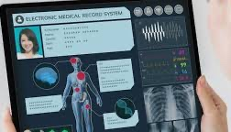
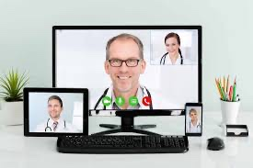
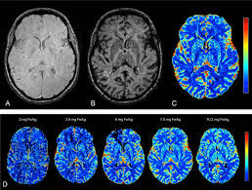
Deliver High Quality and Secure Virtual Care
Optimized User Experience
Real-time Patient Monitoring
Increased Employee Collaboration
Efficiently Share Patient Records
The Network is “Critical Component” of Virtual Care
Notes:
Optimized User Experience – DMPO
Real time patient monitoring – low latency
Increased Employee Collaboration – cloud applications such as zoom, office 365
Share records – common use case, medical images with very large file size need to be shared
To summarize

Slide 17








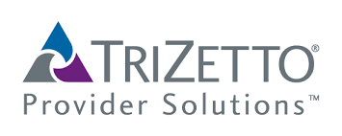









Work from Anywhere
Reliable VOIP, UC, Collaboration, and SaaS access
Improved user experience with an optimized last mile
Automated and Simplified operations
Non-Business Internet Traffic
SD-WAN
VMware SD-WAN Orchestrator
VMware
SD-WAN Edge
Hospital
UCaaS/SaaS/IaaS via
VMware SD-WAN
Gateway
Internet
VMware
SD-WAN Edge
Home
VMware SD-WAN Edge
LTE
Mobile
Network
Enterprise Data Center
VMware
SD-WAN Edge
Remote Clinic
Notes:
Whether doctor at a hospital
Customer Service Representative working out of their home office OR a
Doctor working from a remote clinic with no broadband
Each of these locations have a SD-WAN Edge that connects them to internet…. With the magic of VMware SASE PoPs located all across the globe,
All these are connected, and they are all connected to the SaaS based applications
What this means is
They get reliabl eand secure access to apps that are essential to do their job
Their last mile is optimized

Slide 18
Payer Work From Home – Call Center
Improve Call Center Agent Productivity with reliable and secure access
Non-Business Internet Traffic
Call Center
Agents –Work
From
Home
LTE
Mobile
Network
VMware SD-WAN Orchestrator
UCaaS/SaaS/IaaS via
VMware SD-WAN
Gateway
Internet
VMware SD-WAN Edge
LTE
Mobile
Network
Payer Data Center

Slide 19
Security & Compliance
Enforce Zero Trust Security
Safeguard Against Threats
Meet HIPAA & PCI Compliance
Notes:
Enforce Zero Trust Security -> Users are given access to applications based on context and policy (Users accessing the apps securely) -> tunnel is from user to the app… not going to the data center (show the zero trust)
Safeguard Patient Data -> we can detect PII and block it,
Enforce Zero Trust Security -> ZTNA (conditional access only to user that need to )
Safeguard Against Threats -> if a user accesses web or SaaS apps, prevent against known or unknown malware;
HIPAA and PCI -> segment the networks (PCI traffic stay on PCI segment), layered defense -> users not given access to certain websites -

Slide 20

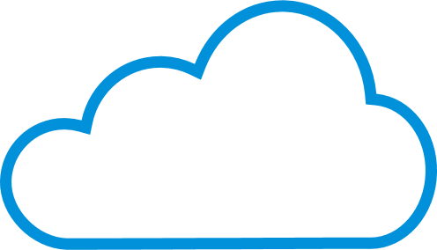



Cloud-delivered Comprehensive Security
Content Filtering
Block/ Allow files, executables, documents, archives
Anywhere
Protect users against websites spreading malware, stealing information, hosting inappropriate content
All Apps
URL Filtering
Anti-Malware
Protect against known threats
WS1 managed
Secure Access
Web
SaaS
Data Center
Standalone
IaaS
On-prem DC
Decrypt SSL/TLS traffic for inspection
SSL Decryption
Sandbox
Protect against Day 0 threats
Clientless (Browser)*
Horizon VDI*
Users / Devices Network Workloads
Protect against loss from accidental or intentional sharing of restricted data
Data Loss Prevention
CASB
Visibility and control into user actions while accessing SaaS applications
Protection, Visibility, Control, and Compliance
Notes:
VMware Secure Access is a VPN replacement solution. It combines the industry-leading SD-WAN and VMware Workspace ONE to deliver a consistent remote work experience to remote mobile users, all based on the principle of Zero Trust Network Access (ZTNA).
VMware Secure Access leverages the proven UAG (Unified access Gateway) stack in the on-premises data center environment, cloudifies it in container applications, horizontally scales it, and offers secure remote access from the cloud.
SSL decryption: 80% of web applications are SSL encrypted. CWS provides scaling to handle more traffic that are encrypted for these applications but also handle more new apps being introduced.
URL filtering helps IT control which web sites users can access
Content Filtering helps control the type of document and file that can be uploaded or downloaded
Anti- Malware helps protect users when they download email, documents or access active web sites against known virus
New virus continue to get introduced daily and it is imperative the solution can respond to Day 0 malware attacks. CWS uses Sandbox to offer protection from Day 0 attacks
Cloud Access Security Broker enables IT teams to get visibility into sanctioned and unsanctioned SaaS applications. This helps IT determine what activities can users undertake when they access these applications. Can employees login, upload and download files from Drop Box. Should summer interns only be allowed to upload documents to Drop Box. Can contractors who are allowed to download files from Drop Box attach that file to the LinkedIn email
Data Loss Prevention. CWS ensures sensitive company data does not leave the enterprise perimeter

Slide 21
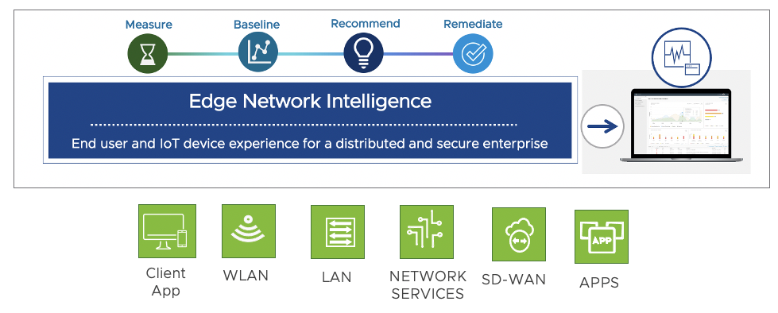



Visibility Into End-user and IoT Device Experience
Applications
Having Zoom issues WFH Is it home Wi-Fi, broadband, VPN or the App
My patient monitoring device is talking to unknown app. I did not know.
How many users at my hospital are affected by poor Wi-Fi or DHCP?
How does user experience at a clinic compare to other clinics?
WFA User Experience
Critical Devices/ IoT Operational Assurance
Remote Site Wireless Operational Assurance
Operational Efficiency
Notes:
High Level:
The main focus for VMware Edge Network Intelligence is visibility into end user and IoT device experience when these devices access applications in the cloud. Our solution helps IT focus on outcomes rather than root cause
ENI helps answer questions like a mobile user is having issues with their Zoom application – is it due to their local Wi-Fi, broadband, VPN connectivity, or is it the application
My IoT device like an infusion pump is talking to an unknown app. I did not know about but ENI does and it will alert you
How many users at my branch location are affected by a service like DHCP or due to poor Wi-Fi - ENI provides the answer to such questions
How does the user experience at a site compare to other sites or to the industry – ENI drives operational efficiency
The use cases addressing these questions are called out ex: WFA User Experience ….. Operational Efficiency
************************************************
Next level detail:
VMware Edge Network Intelligence is an AIOps solution for VMware SASE
Today we collect data about the user experience from multiple sources like the Client App, Wireless and Wired LAN, Network Services like DHCP and DNS, SD-WAN and the Apps
We measure the performance using this data and automatically establish baseline for the users performance
When there is deviation in the performance we alert operations with recommendations on what to do and how to remediate the problem

Slide 22
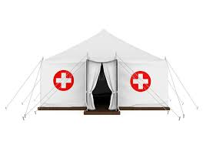
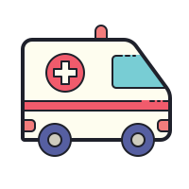
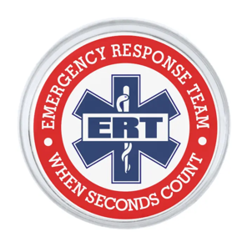
Remote/Mobile/Pop-Up Clinic Over Broadband, LTE and Satellite
Rapidly Bring Up New Sites
Deliver Care in Underserved Areas
Provide ERT reliable, secure access
Notes:
One of you helped deliver three fully operational VMware SD-WAN networks were deployed in one day and twelve more not long after, with direct connections to the hospital system’s existing data centers and applications.

Slide 23
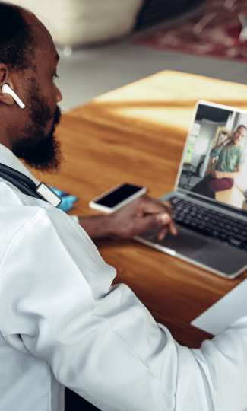



SASE Drives Critical Healthcare Outcomes
Empower Hybrid Workers
Improve Patient Experience
Mitigate Risk and Ensure Compliance
Simplify IT Operations
Empower and scale a modern and secure distributed healthcare workforce
Improve performance and reliability across remote and edge sites
Deliver connected care across networks and devices
Improve patient experiences through personalized services at the edge
Reduce risk, protect against cyber threats, and safeguard PHI across any app, any cloud and any device
Streamline compliance workflows to meet industry regulatory requirements
Achieve HIT operational excellence and reduce costs through data center standardization and automation
Migrate or modernize applications to better align to cloud-based healthcare services
Enable greater business and service continuity at scale across healthcare operations
Notes:
Empower hybrid workers -> getting same experience
Improve Patient experience -> secure, reliable and fast access to apps and data means patients are happy and get the best quality of care…
Mitigate risk and compliance -> comprehensive security capabilities ensure that you are protected against attacks and maintain compliance
Simplify IT Operations -> single pane of glass….

Slide 24
Customer challenges
VMware solutions
2018 – 250 Radiologist moved to VMware SD-WAN
2020: 1,000 (500+250+250) WAN sites deployed in 5 weeks
2020: 3500 additional licenses bought
Automate deployments, management, and troubleshooting
Supplement MPLS with low-cost circuits
Provide improved network visibility and security
Hurricane in 2017 exhausted VPN capacity
Frequent VPN issues: restarts and reboots
Difficulty in providing high performance for radiologists, so chose SDWAN for Radiology
COVID – Non-essential workers force home
Business outcomes
Next steps
Rapid work from home deployment - time to market
Seamless collaboration for 100s of radiologists across the country
Improved performance for radiologists, physicians, and other staff working remotely
User and data protection and privacy
1,500 power users: Physicians with Dell WYSE workstations and large monitors
Address the needs of the regional Care Centers
40+ Mobile Mammography buses
Adopt VMware SASE solution

Slide 25








VMware SASE Healthcare Customers

Slide 26


Want to learn more?
SASE for Health Care
Total Economic Impact Report
Notes:
Plug back to the demos

